Slide 1
Power Automate Desktop Flows

Slide 2
Module Agenda
Create and Manage Desktop Flows
Desktop Flow Logic
Automating Desktop Applications
Automating Web Applications
Advanced Flow Scenarios
Deploy and Monitor

Slide 3
Module 1: Create and Manage Desktop Flows

Slide 4
Module 1 – Introduction
The Microsoft Power Automate for desktop platform consists of two main components that enable you to create and manage flows, the console and the flow designer.
In this module, you will:
1
Explore the console and the flow designer.
2
Learn how to use the core features of the Power Automate for desktop platform.
3
Create and run a flow.
Notes:
The console is the main control panel of the platform from which you can launch the flow designer to create or edit flows. Through the console's options, you can also delete, rename, and run existing flows.
The flow designer is the development environment of Power Automate for desktop, where you can build flows and perform debugging. To develop a flow, you can drag and drop in the main workspace any of the available actions.
Prerequisites
Power Automate for desktop should be installed on your machine.

Slide 5
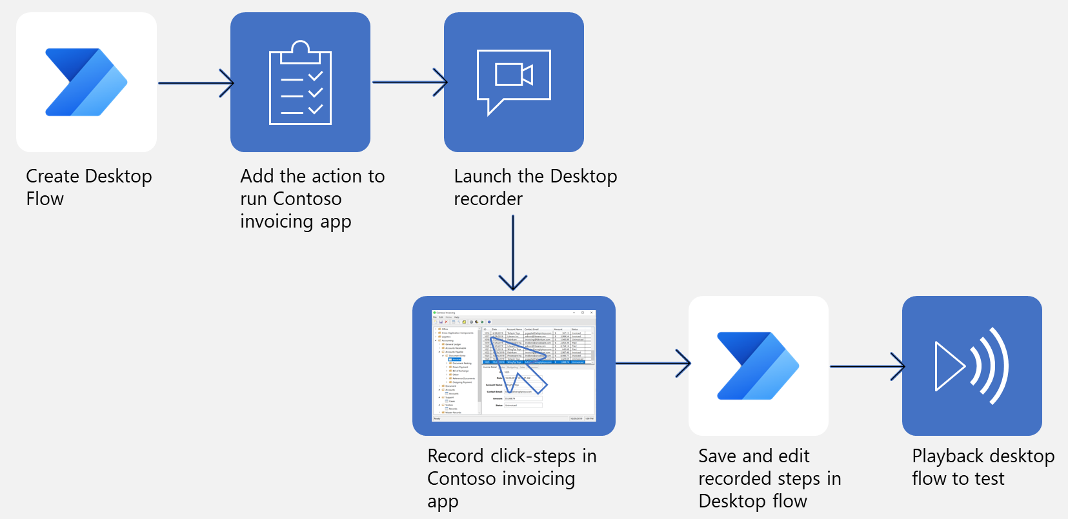
Steps to Create, Record, and Run a Desktop Flow

Slide 6
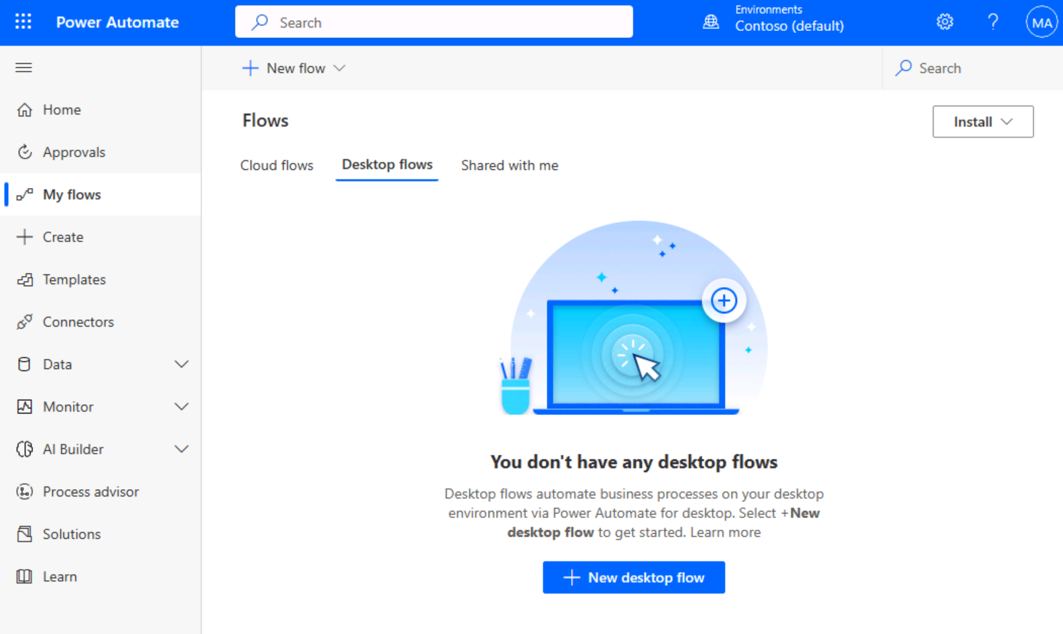
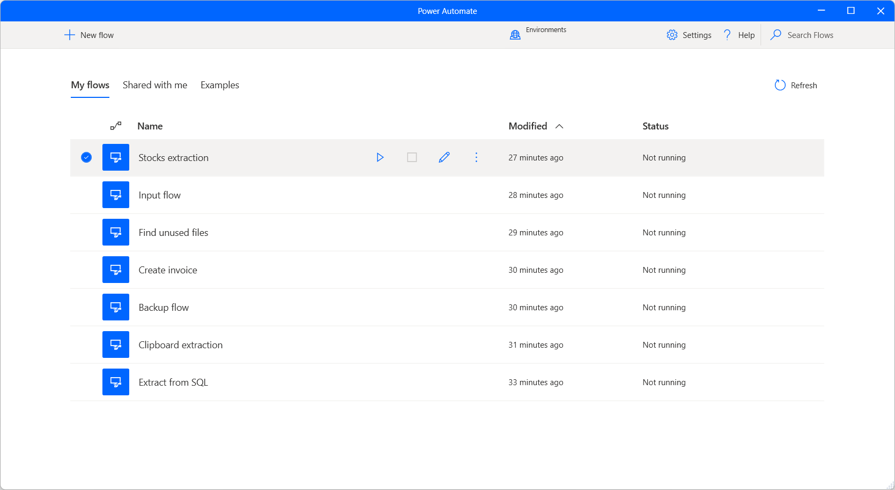
Two Options for Creating a Desktop Flow
make.PowerAutomate.com
Power Automate for Desktop

Slide 7
Power Automate Console
When you launch Power Automate for desktop, the first window that appears on the screen is called the console.
The console is where you can manage your existing desktop flows and launch the flow designer to edit them or create new ones.
To run, stop, or edit a flow more efficiently, you can use the icons next to its name.
Notes:
Also, to handle an existing flow, right-click on it and choose between starting, editing, renaming, and deleting it. If the flow is currently running, the additional option to stop it is available.
Note:
Environments are spaces to store, manage, and share your organization's business data, apps, chatbots, and flows. They also serve as containers to separate apps that might have different roles, security requirements, or target audiences.

Slide 8
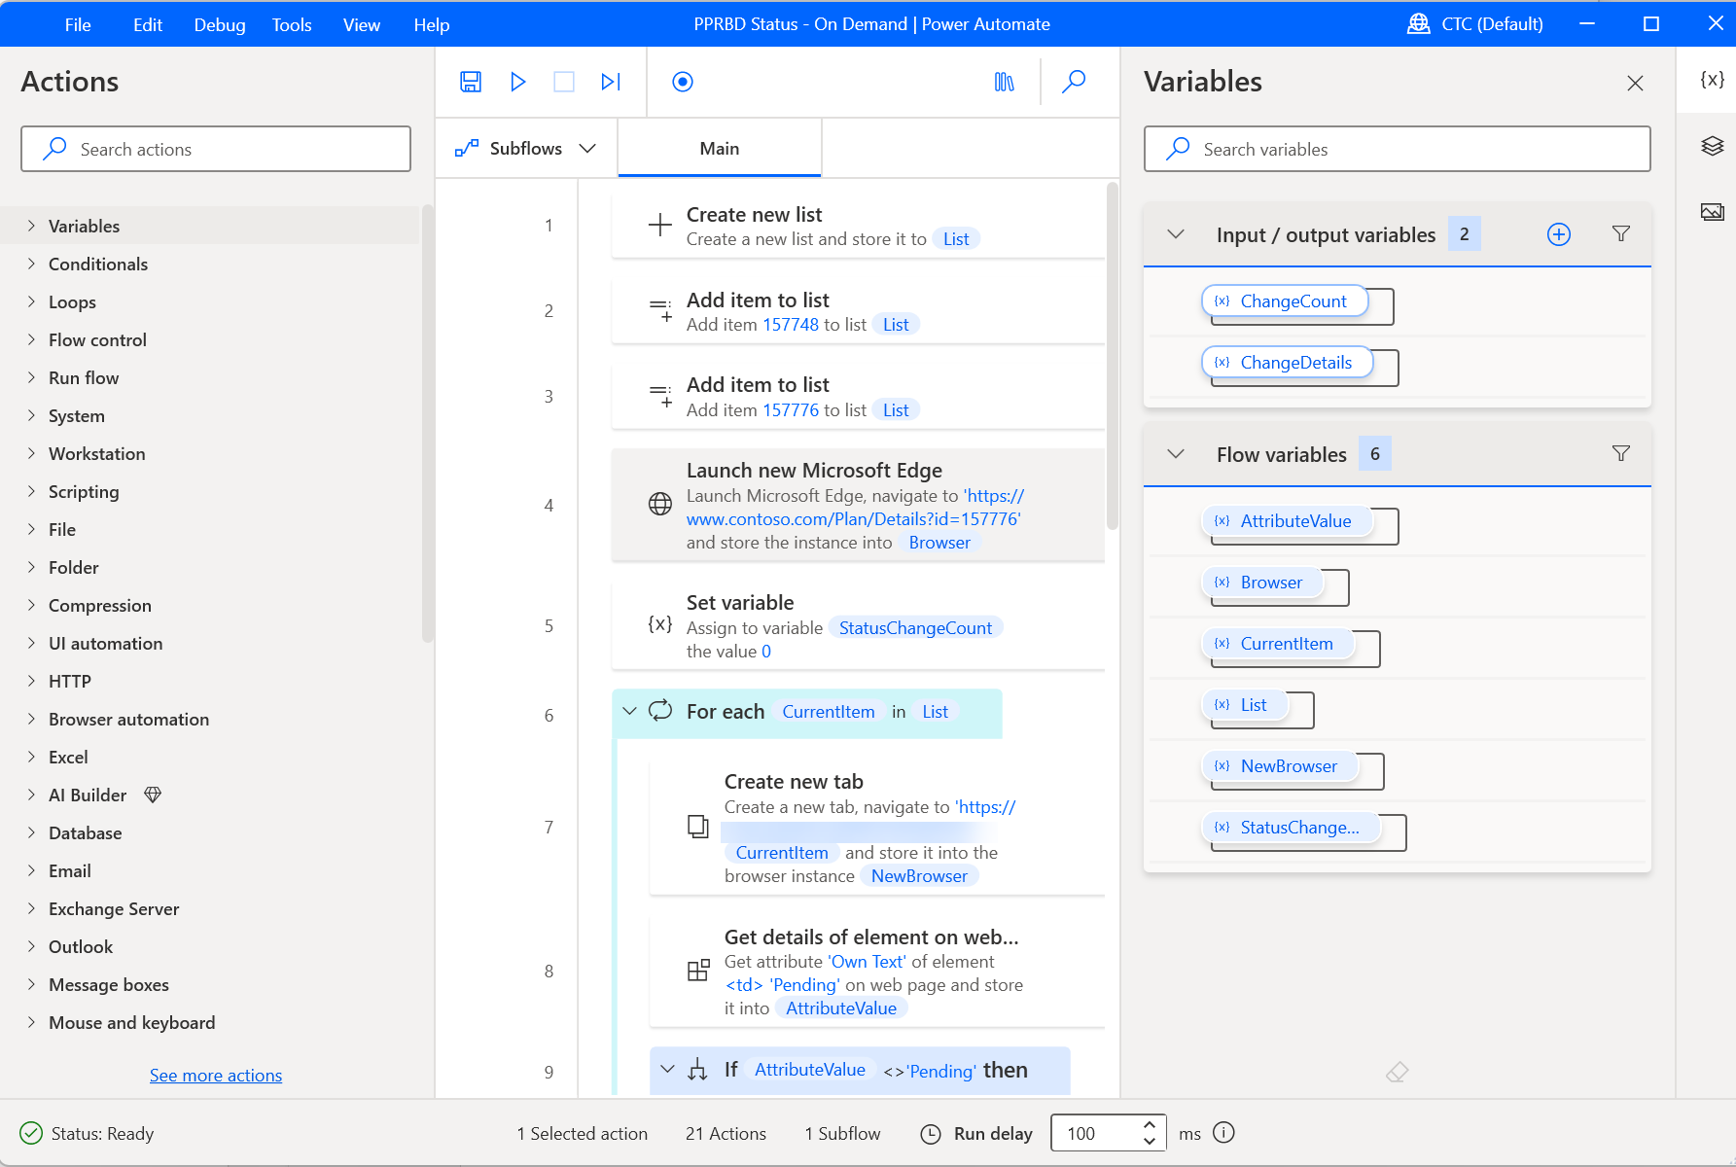
Desktop Flow Designer – Toolbar
Toolbar
Contains basic operations for use with actions (save, undo, copy, debug, and paste) and buttons to start the desktop/web recorders and control the process implementation (start/pause/stop).

Slide 9
Desktop Flow Designer
Subflows
Allows you to create additional subflows under your Main flow

Slide 10
Desktop Flow Designer – Actions
Actions
Contains all Power Automate actions and includes a search bar that helps you find specific actions by matching the action name to the text string.

Slide 11
Desktop Flow Designer – Workplace
Workspace
Contains all actions that are added to the process so far.
This is the logic for your flow.
Functions are separated into tabs.

Slide 12
Desktop Flow Designer – Input/output Variables
Input/output variables
Contains all the input and output variables you’ve defined.
This will be used when you want to pass data to/from cloud flows.

Slide 13
Desktop Flow Designer – Flow Variables
Flow variables
List of all variables that are used in the process.

Slide 14
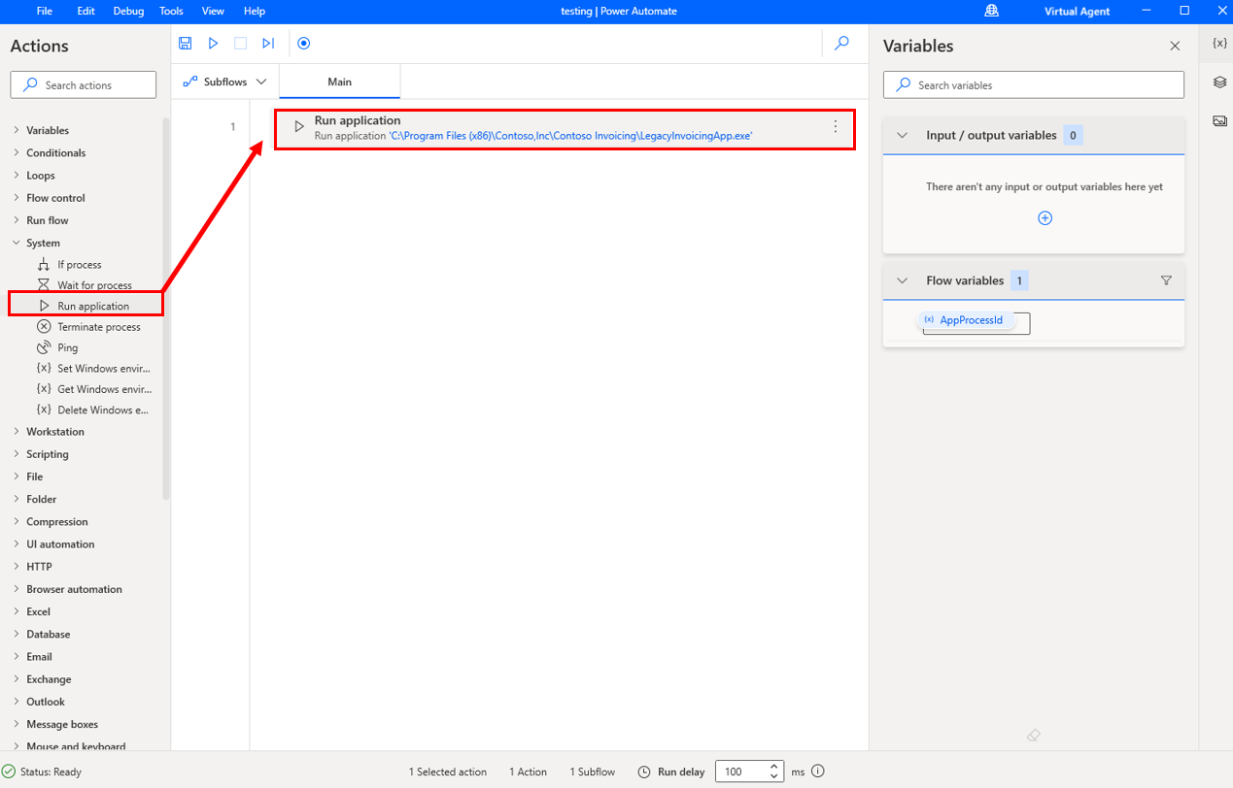
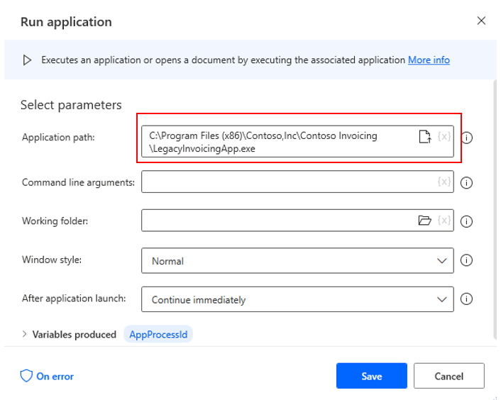
Adding the Application to Run
Notes:
To add actions to your flow, select the desired action and then drag it to the Main canvas. Under the System dropdown menu on the Actions Pane, select and drag Run Application. You'll use this feature to open your invoicing application.
specify the path to the application by entering the location manually; however, by selecting the icon on the right, you can select the application from a file explorer. You can search in the file explorer if you don't know the exact location of your application.

Slide 15
Before Recording Actions
1
Exit out of unnecessary applications while you’re recording
2
If you have more browsers running, you should close them
3
Practice what you plan on recording, it will make the recording better

Slide 16
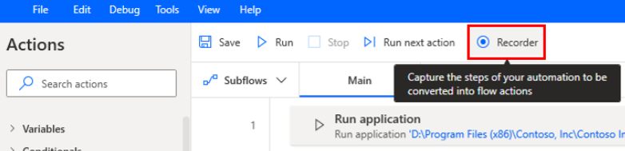
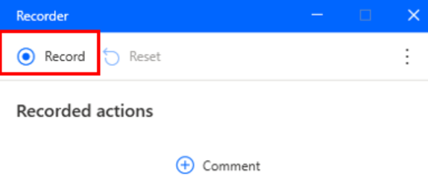
Start Recording
As you record, make sure that you go slowly and wait several seconds between actions.
A red outline will display on a control before you select it, and a blue highlight will display afterward. If these outlines and highlights don't appear, your actions might not be recorded properly.

Slide 17
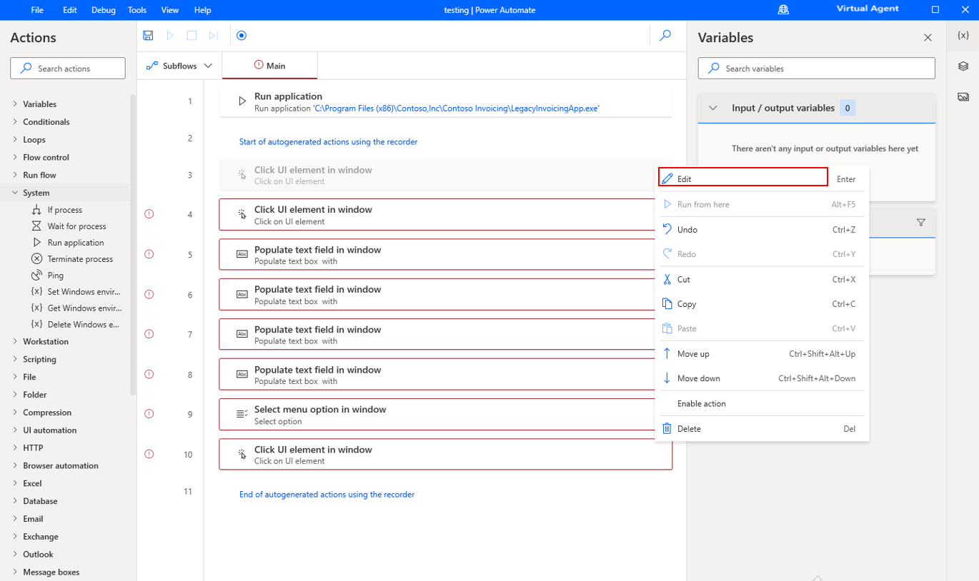
Edit Recorded Actions
You can edit the recorded steps to correct mistakes you made during recording.
For example, you can reorder, copy, or delete actions as needed.

Slide 18
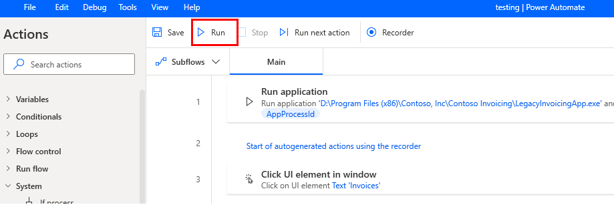
Test your Flow
Test your flow by selecting the Run icon in the toolbar.
Avoid using your computer to perform actions while the test is running.

Slide 19
Exercise: Create and Run a Desktop Flow
Follow the exercise on Learn
In this exercise, you’ll create a flow that copies a selected folder and then adds information about the created backup in a Microsoft Excel file.
Time estimate: 15 minutes
Notes:
https://learn.microsoft.com/en-us/training/modules/pad-first-steps/5-exercise-create-simple-flow

Slide 20
Module 1 – Summary
Power Automate for desktop consists of two components: The console and the flow designer.
These components provide all the essential functionality to manage and develop flows.
Additionally, Power Automate for desktop supports data exchange with Power Automate through the input and output variables.

Slide 21
Module 2: Desktop Flow Logic

Slide 22
Module 2 – Introduction
Adding actions, you can build the logic in your desktop flow.
In this module, you will:
1
Learn how to use actions and variables
2
Use conditionals, loops and flow control to shape your flow logic
3
Use subflows to compartmentalize and reuse parts of a flow
4
Understand the testing and debugging features of the flow designer
Notes:
Prerequisites
Basic familiarity with the Power Automate for desktop console

Slide 23
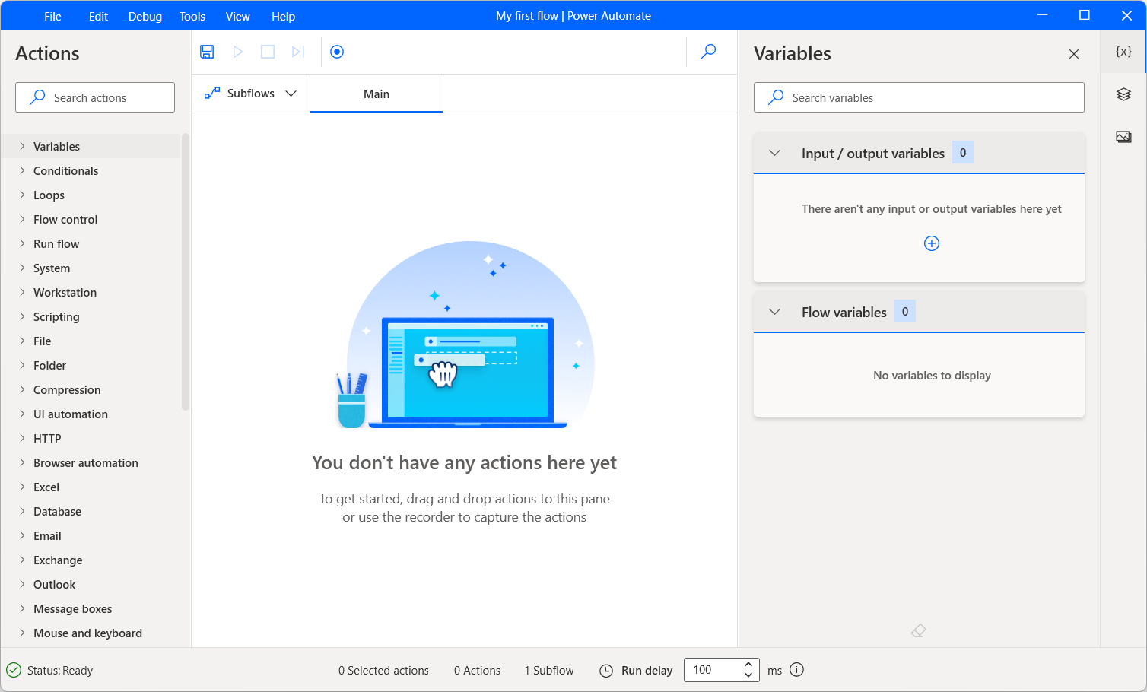
Create a Flow in the Flow Designer
Create a new flow
The flow designer is where all flows are built, edited, and tested.
Actions
Actions are the basic building blocks of a flow; flows are essentially series of actions, which are run sequentially.
Variables
Variables are data containers that Power Automate for desktop uses to store data for later use.
Notes:
The creation of a flow takes place in the Power Automate for desktop console. On the top-left, press the New flow button to create a new flow.
Enter the name of your new flow and select Create; this will open the flow designer window.
To add an action to the flow, drag & drop it from the actions pane to the main workspace pane, or double-click on it. The actions pane is located by default on the left-hand side of the flow designer.
When added, the action’s properties window automatically appears, allowing the user to configure the action’s details.
Variables are contained between percentage marks, which allows them to stand out from simple text.
Variables can be produced as output from actions, or used as input for other actions. Opening an Excel worksheet, for example, produces a variable containing the Excel instance. This variable may then be used as input in any following actions that require interaction with that particular Excel instance:

Slide 24
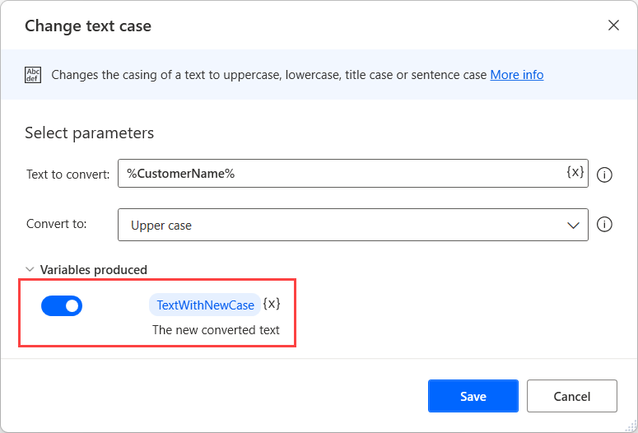
Creating Variables by Adding Actions
Every time you add a new action in the workspace, a variable is created that holds the results.
If you want to change the default name of a produced variable, you can select it and populate the new name.
You can select the toggle button on the left side of it to disable it.
Notes:
Disabling unused variables reduces the number of variables in the variables pane and makes management more efficient.

Slide 25
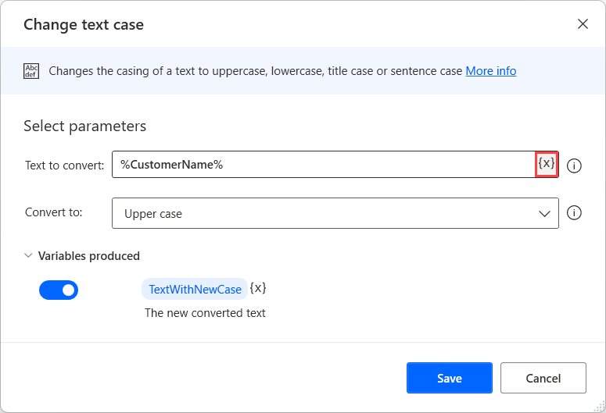
Using Variables as Input to Another Action
To use a variable, select the icon next to the desired input field and pick the variable or a specific property of it
To reference a variable named CustomerName, you could also just type the expression: %CustomerName%

Slide 26
Variable Data Types
When you create variables in your flows, Power Automate converts them to a specific type based on their content
Simple data types
Advanced data types
Text
List
Datatable
Datarow
Custom Object
Numeric
Connector object
List of PDF table info
Boolean
Instances
Connections
And others…
Notes:
https://learn.microsoft.com/en-us/power-automate/desktop-flows/variable-data-types

Slide 27
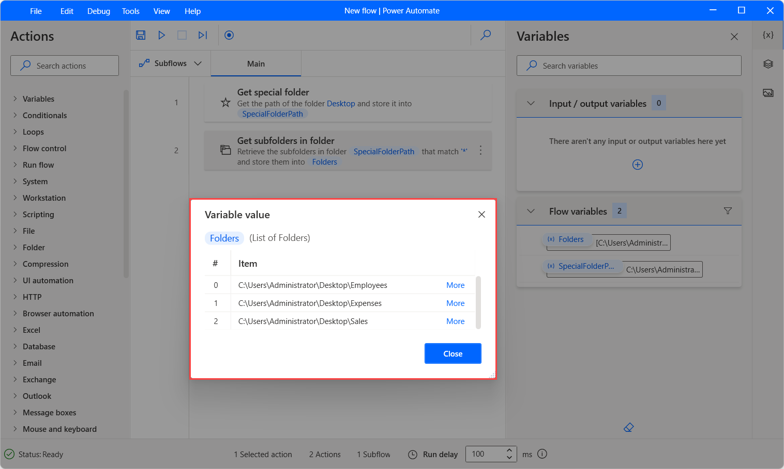
Using Lists
Lists are collections of items
For example, a list of folders you need to process in the flow
You would then use a For each action to iterate through the items in the list
To retrieve a specific item in a list, use the following notation: %VariableName[ItemNumber]%
Notes:
Depending on the types of the individual list items, there can be lists of text values, lists of numerical values, and so on. The list data type is the equivalent of a single-dimension array in programming terms
Keep in mind that the index should be 0 for the first item of the list.

Slide 28
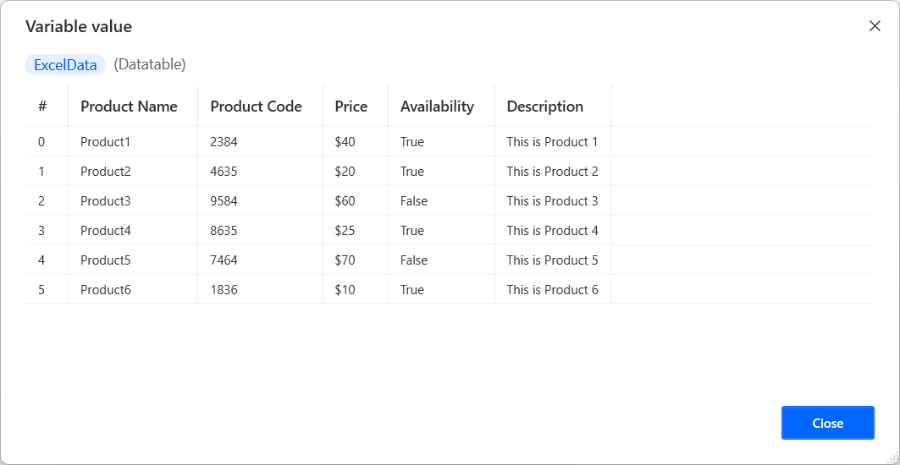
Using Datatable
Datatables contain data in a tabular form like a worksheet in Excel
A datatable contains rows and columns that describe the position of each item uniquely
If you loop through a datatable with a For Each action, the variable that will contain the current iteration’s data is considered to be a datarow
Notes:
equivalent of two-dimensional arrays in programming terms

Slide 29
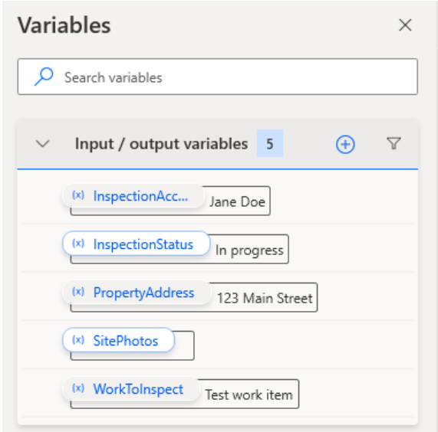
Input and Output Variables
Enables data exchange between cloud and desktop flows
You can also use input variables to set values manually when the flows are triggered through the console

Slide 30
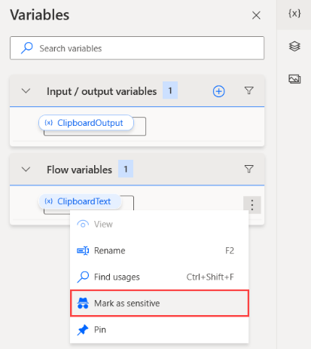
Sensitive Variables
Some automation scenarios handle confidential information
Values are masked during debugging in the variables pane of the flow designer
You can use, manipulate, and process sensitive variables in every action without any limitation, like every other variable
Notes:
The flow designer handles sensitivity as a mask that you can set on and off.
Sensitive variables aren't meant to provide protection over hardcoded data. You shouldn't hardcode critical data in plain text, like passwords and PINs, in the properties of actions like Set variable, even if the said variables are marked as sensitive. The desktop flow logs will be protected, but the hardcoded values are visible in the modal and the flow definition in Dataverse.
Sensitivity isn't inheritable in variables. If you add or assign a sensitive variable to another variable, the resulting variable won't be sensitive by default

Slide 31
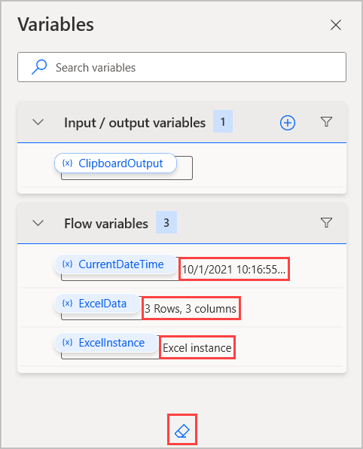
Manage Variables and the Variables Pane
You can search for variables, rename them, find their usages, marking them as sensitive, pin them, and filter them by type
When a flow runs, the current value of each variable is visible next to its name
Eraser icon at the bottom of the variables pane clears all the current values
Notes:
To examine the value of a variable in more detail, double-click on it. The variable value viewer displays the datatype of the selected variable and expands any datarows or datatables to show their contents.
Certain data types may contain nested elements. For example, a custom object may contain another custom object in its properties. To view the properties of the nested element, select More.

Slide 32
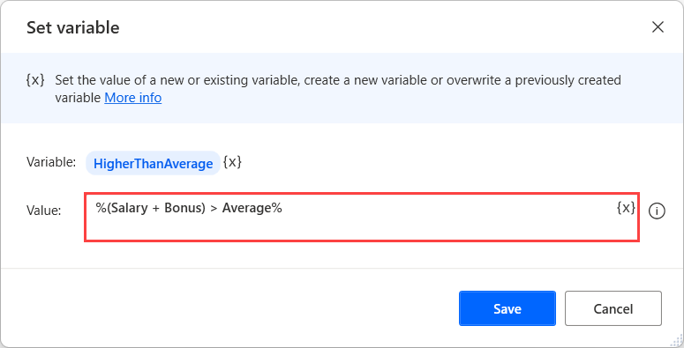
Set Variable Action
Use the Set variable action to modify the value of a variable
Create complex expressions containing hardcoded values, multiple variables, arithmetic operations, comparisons, logical operations, and parentheses

Slide 33
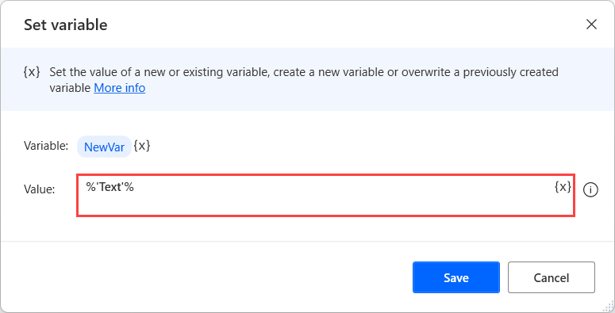
Hardcoded Values
To enter a hardcoded value, you have to use quotes
The flows treat every value between quote characters as a text value rather than a variable name

Slide 34
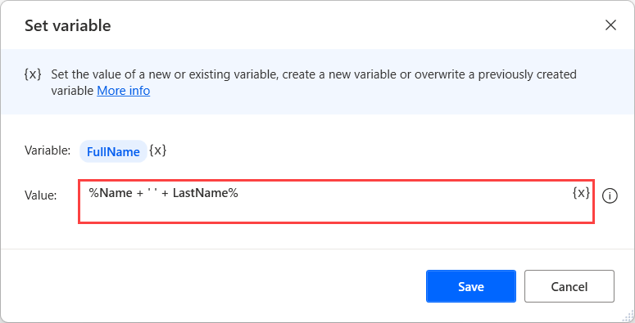
Using Multiple Variables in an Expression
You can add their names to the expression without any further notation
For example, you need to build a full name from first and last parts

Slide 35
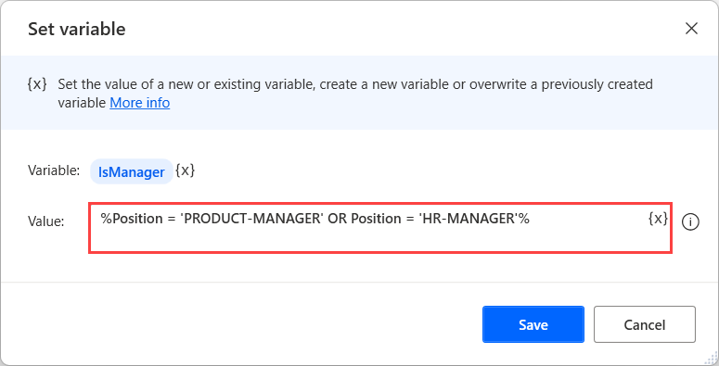
Logical Operators
To check conditions and implement more complex logic in a single expression
For example, Set IsManager variable to true if position matches
Supported operators are AND and OR

Slide 36
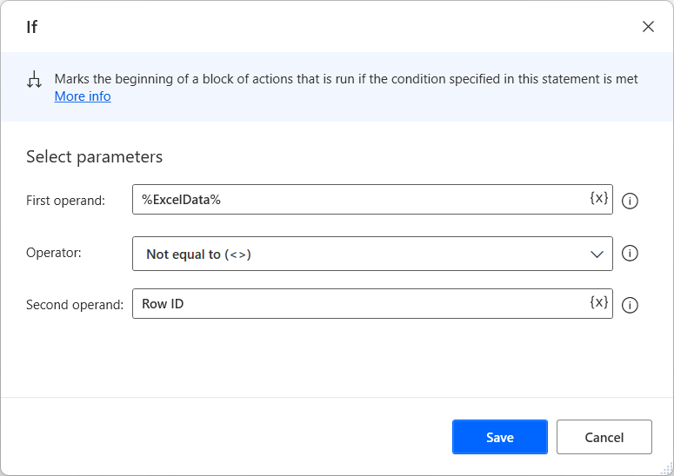
Create Conditionals and Loops (1/2)
Conditionals
Conditional actions allow flows to modify their behavior during runtime, based on the data available at the time.
Essentially, they allow flows to make choices based on the information at their disposal.
Notes:
As mentioned before, actions within a flow are run sequentially. However, there are certain actions that may alter this sequence, to achieve greater flexibility and adaptability while running a flow.
In this unit, we will examine two main categories of such actions: Conditionals and Loops.

Slide 37
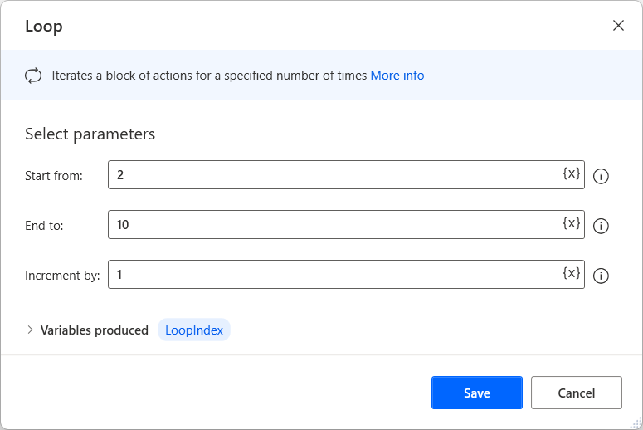
Create Conditionals and Loops (2/2)
Loops
Loops enable flow to repeat a block of actions multiple times.
The number of repetitions is determined by the type of loop action used and its configuration.

Slide 38
Flow Control Actions
1
Comment – To enter a comment for reference purposes which is displayed in the workspace
2
Label – Direct the flow to a specific point in the flow marked with the action
3
Go to – Select the label from a drop-down list to direct the flow to it
4
Run subflow – To run another subflow at any point in the flow
5
Exit subflow – To stop the subflow and go back to the point where it was run from
6
Stop flow – To stop running the entire flow
7
On block error action & End action – Place actions that are likely to fail or produce an erroneous result in an error block
Notes:
Comment
Comments facilitate flow design, and allow users to make notes and explain the logic of action implementation and flow design.
Label
Provide a name for the label.
Go to
Use a Go to action and select the label from a drop-down list to direct the flow to it.
Run subflow
When the subflow completes, the flow continues with the next action. The subflow must be specified by name and can be selected from the drop-down list of existing subflows.
Exit subflow
This action does not have properties. The Exit Subflow action is not required at the end of a subflow. When all the actions in a subflow have run, the flow will continue from the point where the subflow was run.
Stop flow
To stop the flow with an error message, set End flow to With error message and specify the message to display.
On block error action & End action
Place actions that are likely to fail or produce an erroneous result in an error block. The On block error action along with its corresponding End action are used to create an error block. Place actions in an error block to prevent the entire block from attempting to complete in the event that at least one of the actions within it fails.

Slide 39
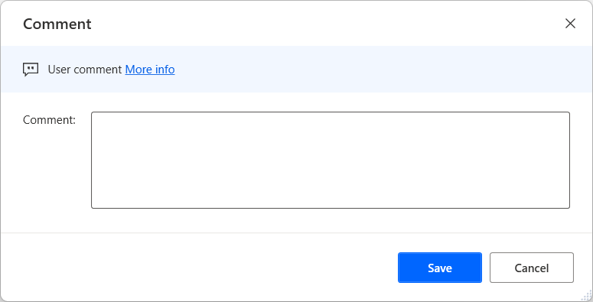
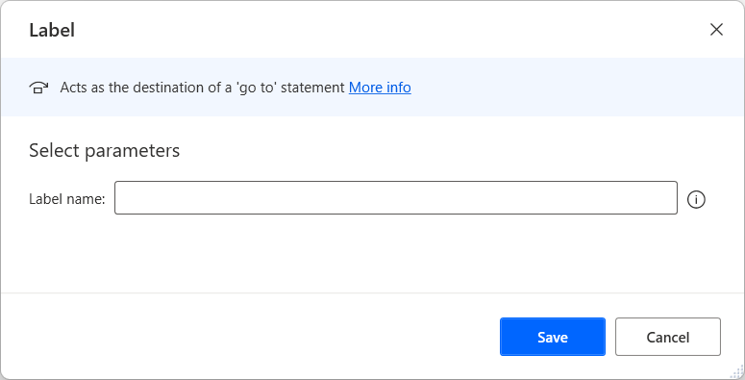
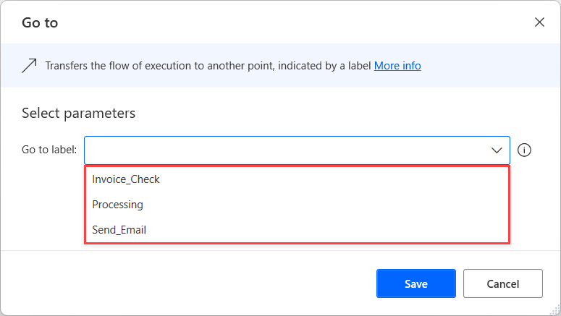
Flow Control Actions(1/2)
To enter a comment for reference purposes which is displayed in the workspace, use the Comment action.
Direct the flow to a specific point in the flow marked with the Label action. Provide a name for the label.
Use a Go to action and select the label from a drop-down list to direct the flow to it.

Slide 40
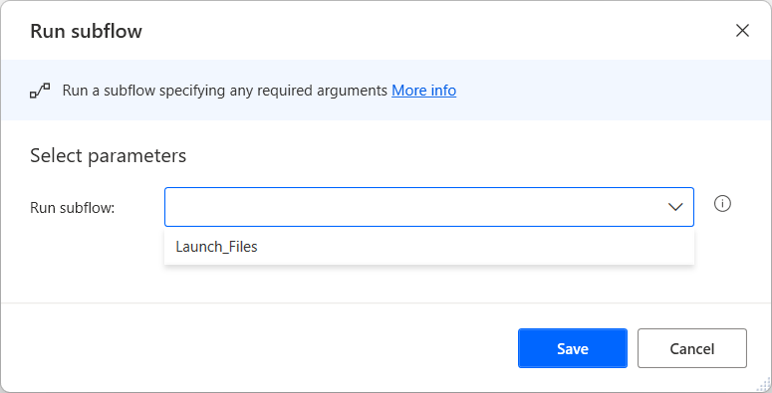
Flow Control Actions(2/2)
To run another subflow at any point in the flow, use the Run subflow action, as shown on the right.
To stop the subflow and go back to the point where it was run from, use Exit subflow.
To stop running the entire flow, use the Stop flow action.

Slide 41
Loop Actions
There are three distinct types of loops
Simple loop
For Each loop
Loop Condition

Slide 42
Simple Loop Actions
Two common uses of simple loops
1
The loop action is used primarily when a predetermined number of repetitions is required.
2
Another common use of simple loops is tasks where the loop index is important to the task itself.

Slide 43
For each Loop Actions
The purpose of the For Each action
1
The For Each action is used to iterate through a list or table of items; it’s therefore common in tasks containing such structures.

Slide 44
Loop Condition Actions
The purpose of the loop condition action
1
The loop condition action is used when a block of actions should be repeated until a certain condition is met – This allows flows to repeat actions without prior knowledge of the number of repetitions required.

Slide 45
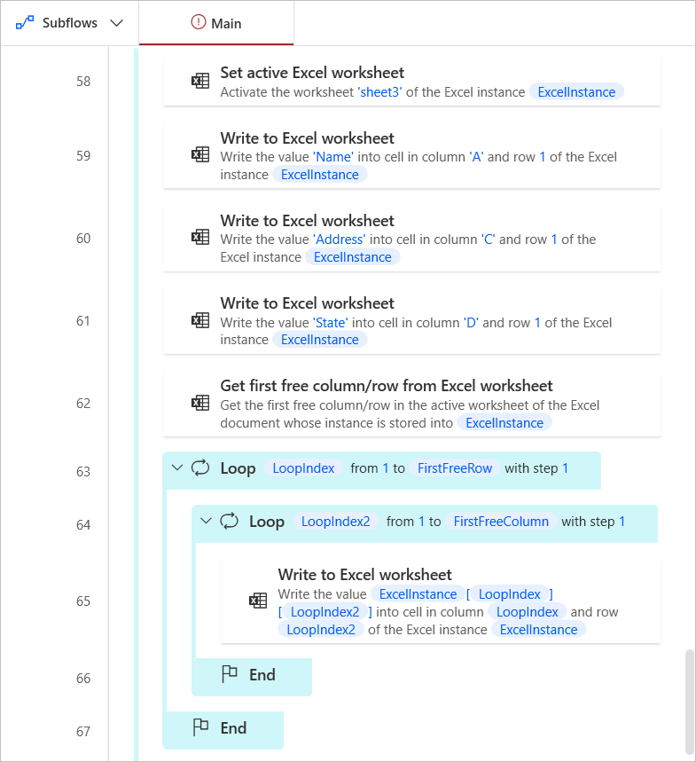
Using Subflows
When a flow contains a large number of actions, it may be split up into subflows, making it more manageable and easier to maintain.
Subflows can be used to organize a flow’s actions, but they also allow the reuse of parts of the flow, which helps to avoid cluttering by copy-pasted actions.
Notes:
Let’s improve this flow‘s readability without changing its functionality, using subflows to break it up into self-contained parts. This can be done through the subflows list on the top-left.
The Main subflow is always present, since it signifies the start of the flow; we will add more subflows by pressing the New subflow button.
An empty subflow is created and named. We will proceed to add a few subflows which correspond to discrete parts of the flow.
New subflows are visible as tabs at the top of the workspace.
Now, we can proceed to move actions from the Main subflow into these new ones
Finally, to run the subflows, we must make use of the Run subflow action..

Slide 46
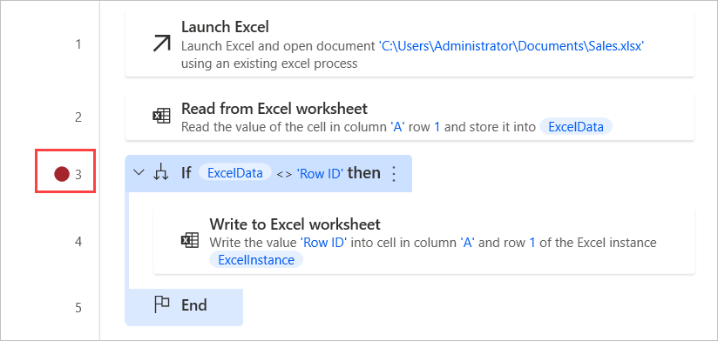
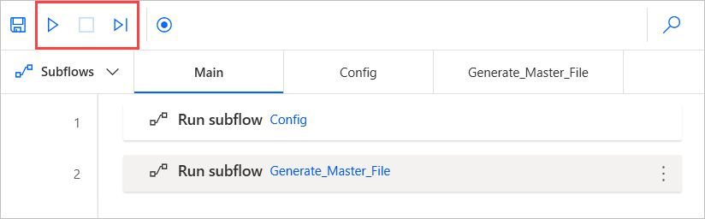
Test and Debug Flows (1/2)
Testing
Flows under development can be run at any time in the flow designer, through the Run button.
It is possible to run, stop, and resume the flow.
Breakpoints can be added to automatically pause the run when a specific action is reached.
Notes:
On the bottom-right corner of the designer, the variables pane contains all the variables used in the flow; information about a variable can be viewed by double-clicking on it. This information is updated in real time, providing users a clear picture of the flow's state at any given time.

Slide 47
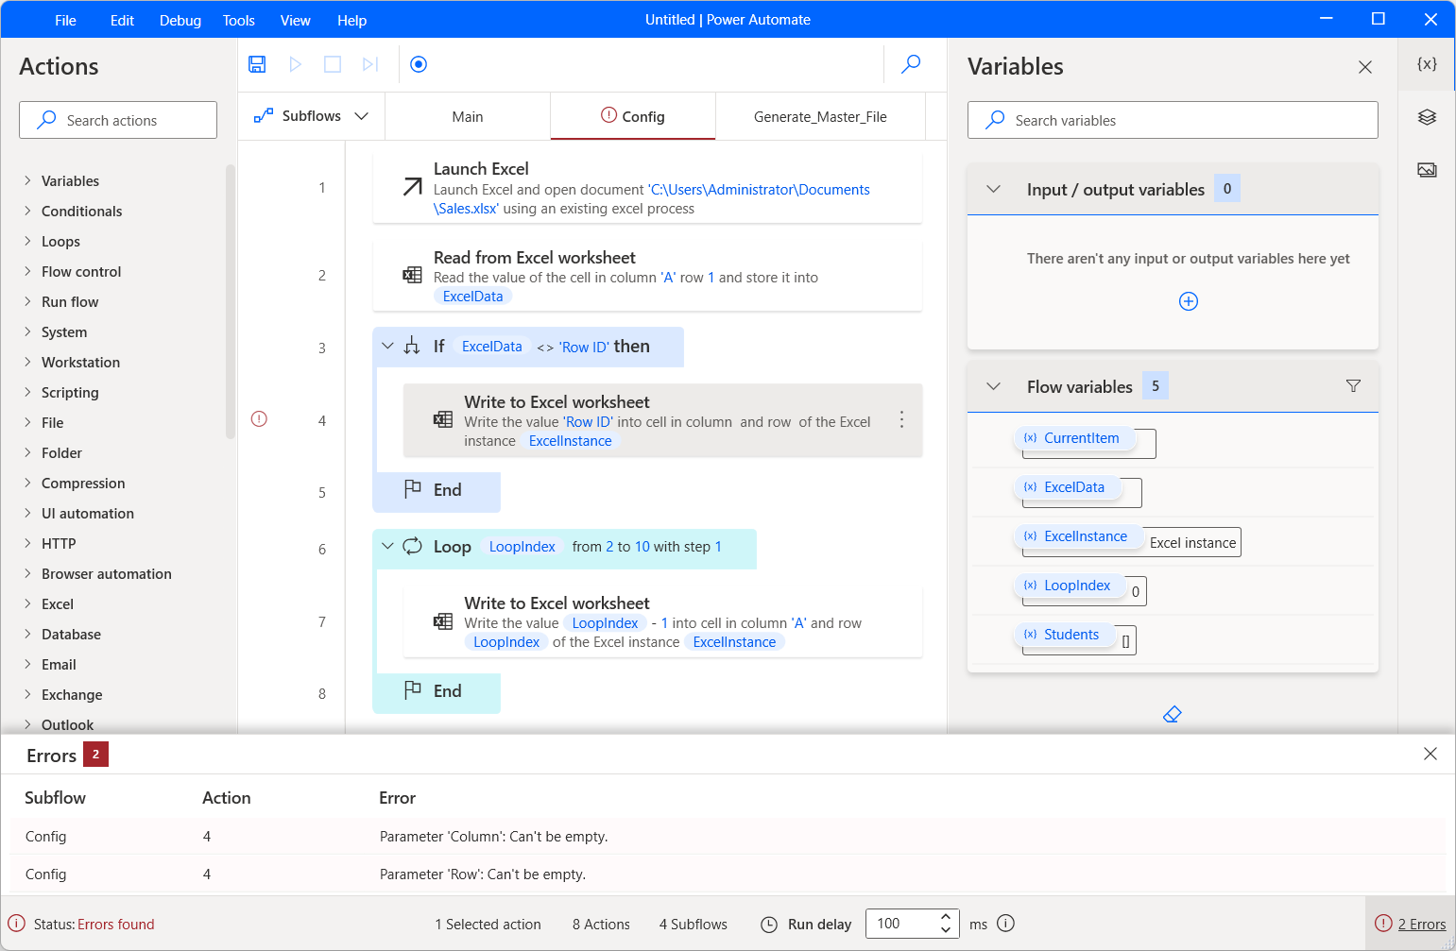
Test and Debug Flows (2/2)
Debugging
In addition to the above, certain features are designed specifically for locating and correcting errors.
Any design-time errors – Errors that are identifiable before the flow is run – Are communicated through red symbols in the designer, while details can also be found in the Errors pane at the bottom of the designer.

Slide 48
Exercise: Use Logic with Desktop Flows
Follow part 1 Use Variables on Learn
Follow part 2 Use Loops on Learn
Follow part 3 Use Conditionals on Learn
Time estimate: 30 minutes
Notes:
Part 1 - https://learn.microsoft.com/en-us/training/modules/pad-first-steps/5-exercise-create-simple-flow
Part 2 - https://learn.microsoft.com/en-us/training/modules/pad-loops/6-exercise-loops
Part 3 - https://learn.microsoft.com/en-us/training/modules/pad-conditionals/4-exercise-if-group-actions

Slide 49
Module 2 – Summary
How to use actions and variables
How to use conditionals, loops and flow control to shape your flow logic
How to subflows to compartmentalize and reuse parts of a flow
The basics of testing and debugging features of the flow designer

Slide 50
Module 3:Automating Desktop Applications

Slide 51
Module 3 – Introduction
Configure desktop flows to perform automation of desktop applications.
In this module, you will:
1
Understand how Power Automate for desktop uses UI elements to interact with local application UIs and windows.
2
Configure and use UI elements from the flow designer’s UI elements tab, or directly from a relevant action’s properties; they can then be used as input in UI/Windows actions.
3
Use UI/Windows actions to interact with entire windows or elements within them.
Notes:
Prerequisites
Basic familiarity with the Power Automate for desktop console

Slide 52
Automating Desktop Applications
1
UI automation actions interact with Windows applications by either providing input with mouse clicks and keyboard strokes or extracting data
2
Actions of the Windows subcategory directly manipulate entire application windows
3
Form filling actions interact with more specific components, such as text fields and buttons
4
Desktop automation can be performed by manually adding the required actions or using the recorder

Slide 53
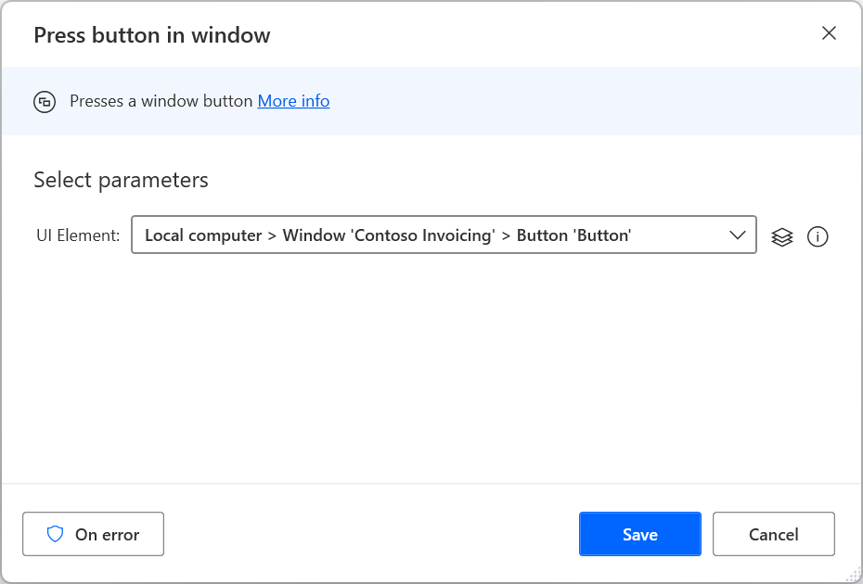
Understanding UI Elements
To identify windows and components in them, Power Automate utilizes UI elements
UI elements uniquely describe each component and can be managed through the flow designer’s UI elements pane

Slide 54
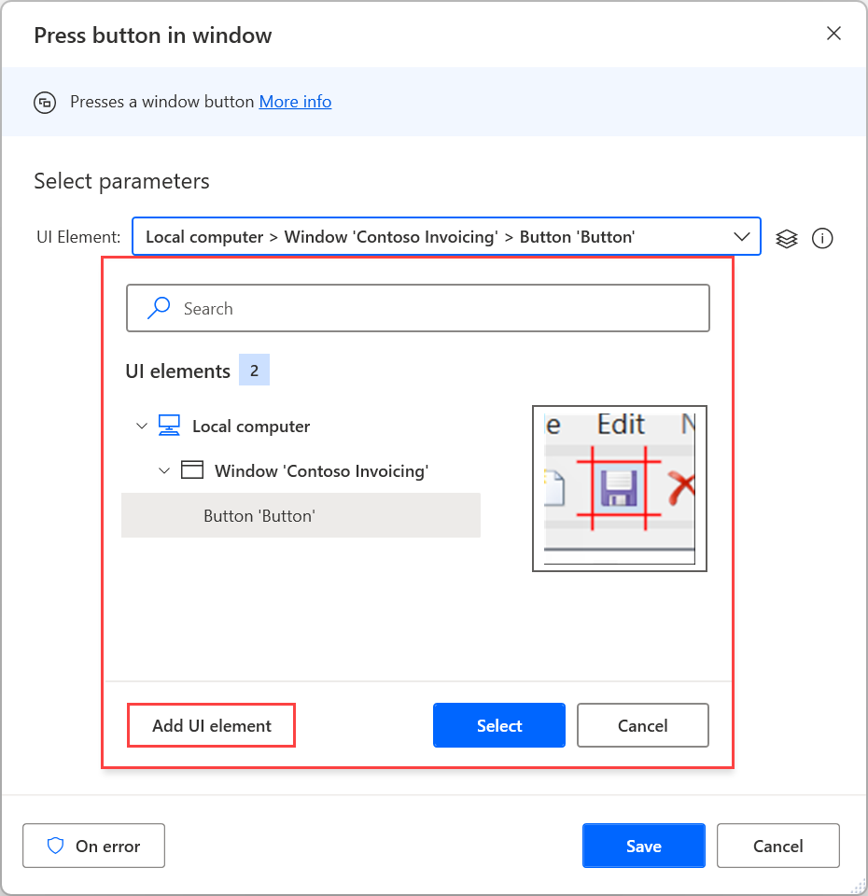
Adding UI Elements to your Flow
Recording automatically adds UI Elements as you record your actions in the application
You can manually add UI Elements from the action properties or from the UI Elements pane by manually identifying them in the application

Slide 55
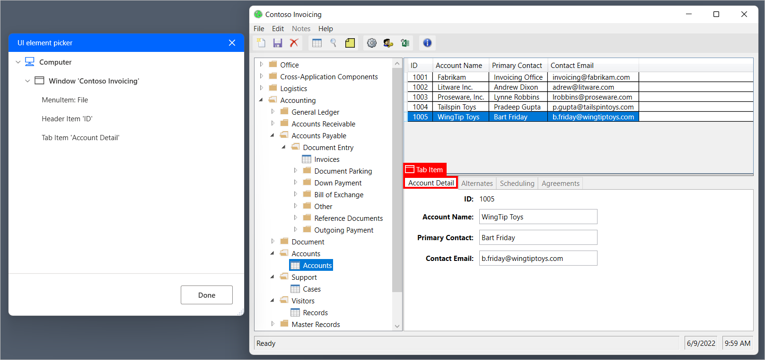
Selecting the New UI Element to Add
Highlight the appropriate element and press Ctrl + Left click
After adding all the elements, select Done to save them

Slide 56
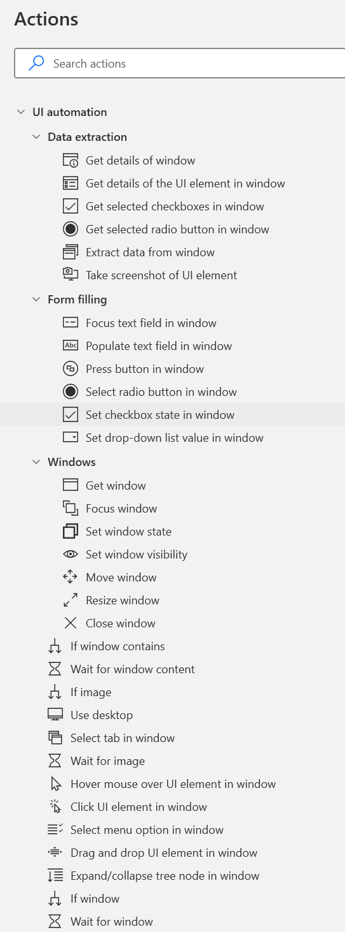
Working with UI Elements
Once identified to the flow you can use UI automation actions
Windows actions allow you to set focus, move windows, close windows and more
Form filling actions allow for populating text, pressing buttons and more
Data extraction is how you get values from the UI Elements

Slide 57
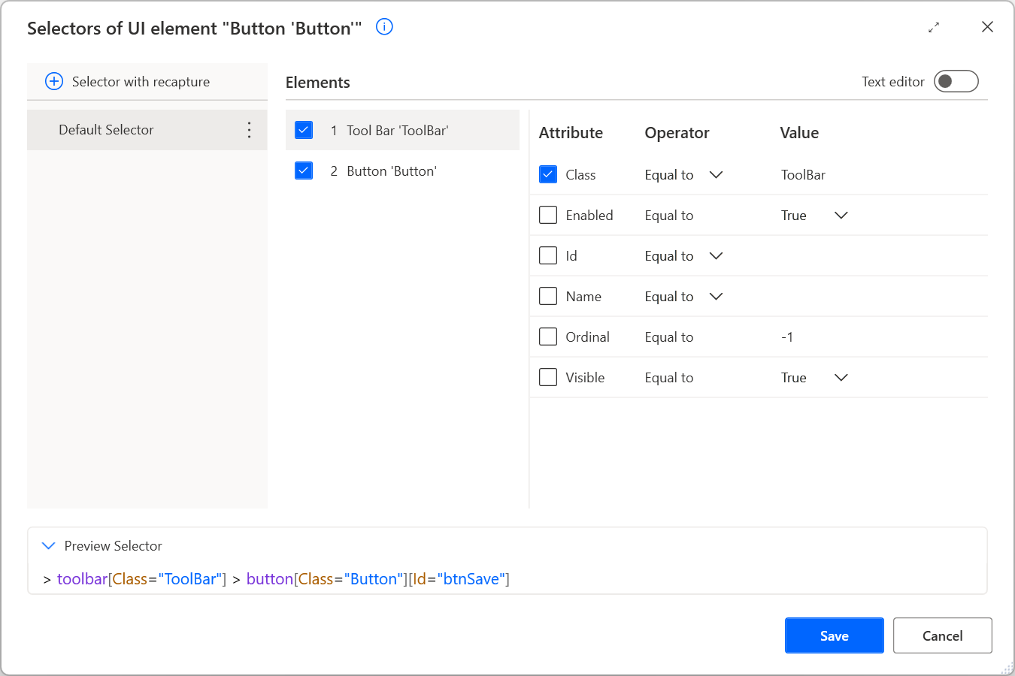
UI Element Selectors
Selectors that pinpoint the UI component that Power Automate interacts with
Users can create multiple selectors for a UI element
Whenever a selector fails, the following selector in the defined order is used

Slide 58
Selector Criteria
Each selector consists of multiple elements representing the hierarchical structure of the UI element in the application
Each selector consists of multiple elements representing the hierarchical structure of the UI element in the application
Notes:
For example, Class with a value of Toolbar uniquely identifies the toolbar element.
You can rename selectors to give meaningful names
You can also change their order and disable them

Slide 59
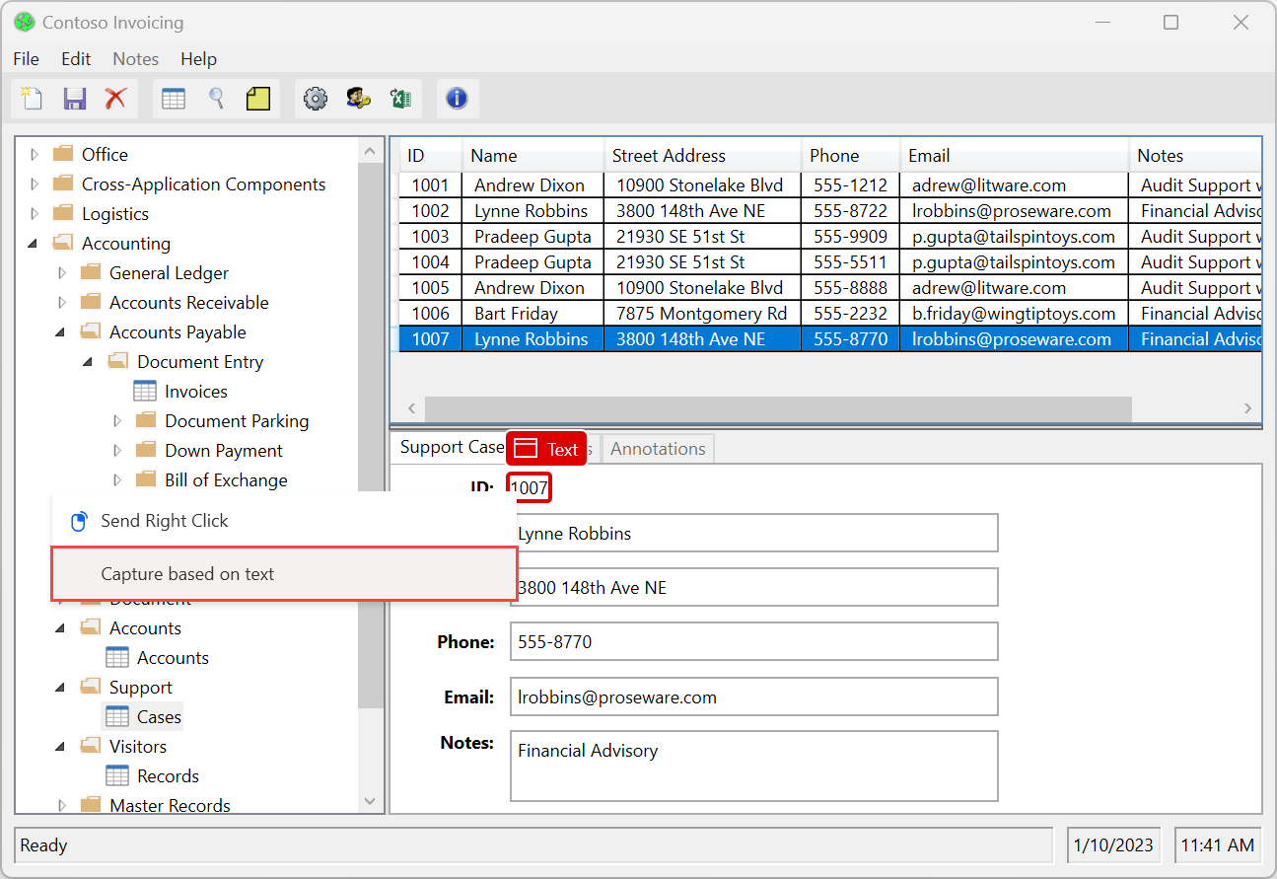
Text-based Selectors
Power Automate supports the creation of selectors based on an element’s text value
Selectors based on these texts are more reliable and resilient to possible future changes in the application
Only available for UI elements with a Name or Text attribute that includes a value
Notes:
Power Automate supports the creation of selectors based on an element's text value
Generating text-based selectors is available only when capturing UI elements using the UI element picker (UI elements pane or browser/UI automation actions). It's not available during recording

Slide 60
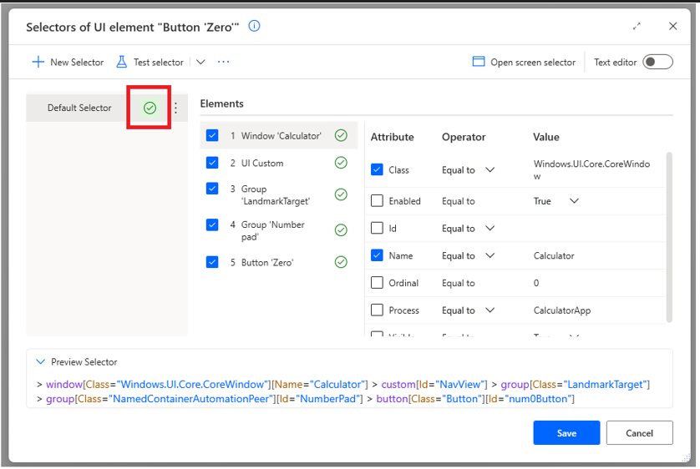
Test Selectors
Enables you to test a selector and ensure that your UI automation flows will run as expected
You must ensure that the UI element is available on your computer
Notes:
Can result in Success, Failure, or multiple identified

Slide 61
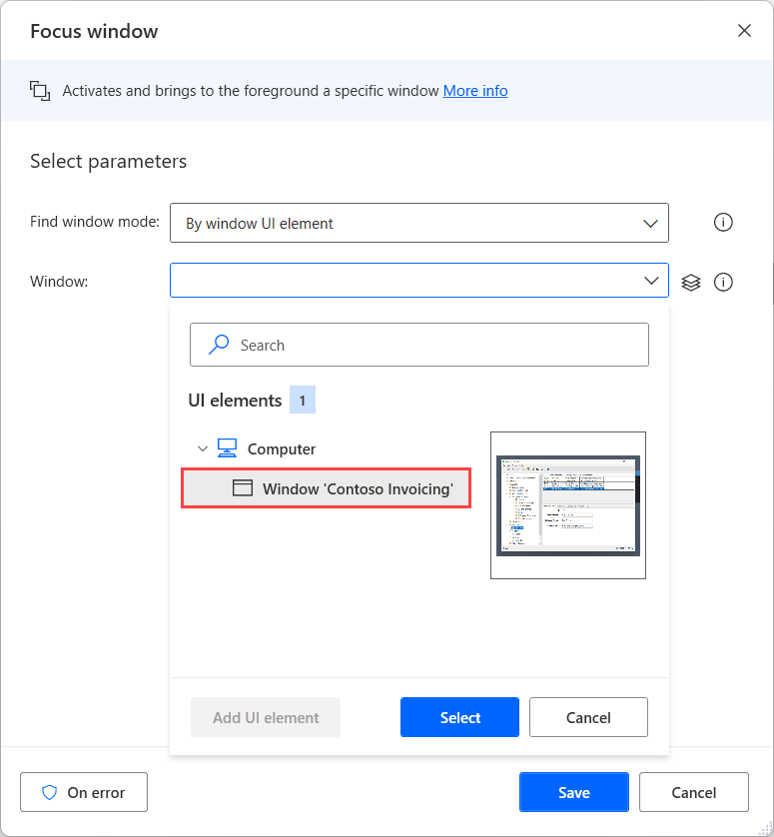
Window Handling and Element Interaction (1/2)
Window handling
The windows sub group of actions is responsible for helping you interact with entire UI windows.
Use the Focus Window action to bring a window to the foreground.
Identify the window by its UI element and then capture it
Use an already captured window element
Similarly, you can add a Set Window State action to maximize the now focused application.

Slide 62
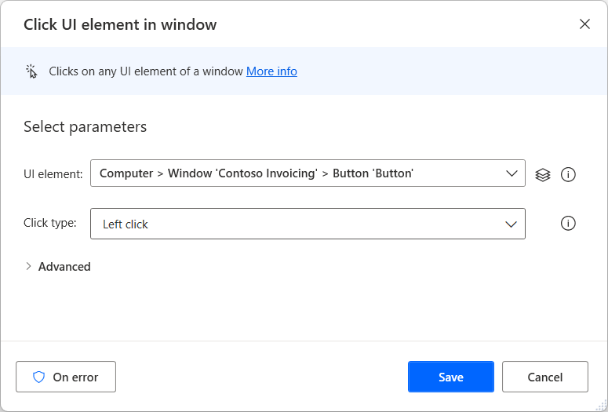
Window Handling and Element Interaction (2/2)
Element interaction
Click Element in Window – To perform a mouse click on a UI element
Populate text field in window – To edit the contents of a text field
Press Button in Window – To save the changes, Select the Save button
Close Window – To close the app

Slide 63
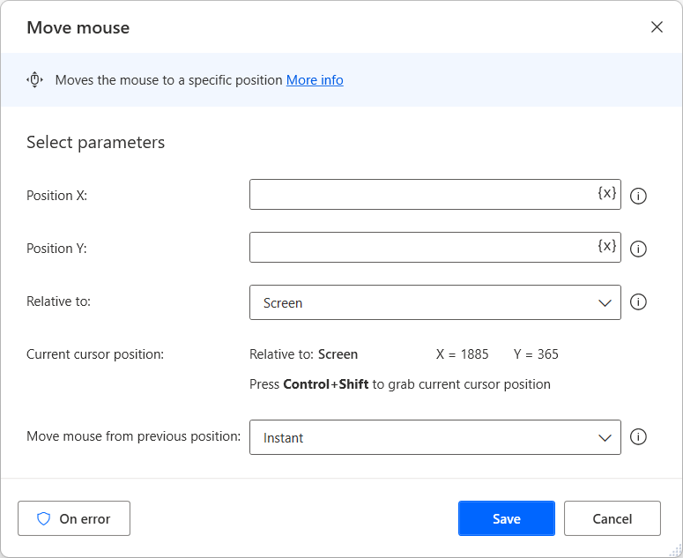
Mouse and Keyboard Actions (1/2)
Mouse actions
Get Mouse Position – To locate the current position of the cursor and retrieve its coordinates
Move Mouse – To move the mouse to a specified position
Move Mouse to Image – Specify an image on the screen to move the cursor to
Move Mouse to Text – Specify a string of text on the screen to move the cursor to
Send Mouse Click – To simulate mouse click(s)
Notes:
Get Mouse Position
Measure the position from either the top-left corner of the screen or the top-left corner of the foreground window. The action measures the cursor's coordinates as mouse position x and y and stores them into two separate variables.
Move Mouse
Specify the target coordinates and how fast to move the cursor. Calculate the coordinates from the top left of the screen, the currently active window, or the mouse's current position. Set the mouse to move to the new position instantly, where the mouse appears to jump from one position to another or use animation to simulate a user's movement of the mouse. Optionally adjust the speed of the animation. To capture the current coordinates of the mouse relative to the screen, press Ctrl + Shift. This will populate the Position X and Position Y fields.
Move Mouse to Image
Specify an image on the screen to move the cursor to with the Move Mouse to Image action. Select the target image from existing images. If no images have been added, they can be captured by clicking on the Capture image button in the pop-out.
Move Mouse to Text
Specify a string of text on the screen to move the cursor to with the Move Mouse to Text on screen. The action moves the cursor to the text, even if it is stored as an image such as a jpg or pdf file. For this action, you must specify an optical character recognition (OCR) engine or an OCR engine variable. The callouts in the following illustration show how to configure this action.
Send Mouse Click
Choose whether the action should wait a number of milliseconds before sending the click. Unless otherwise configured, the action sends the mouse click at whatever position on screen the cursor happens to be when the flow runs this action. Check Move mouse before sending mouse event to show the options of the Move Mouse action. A variable can be used for entering the coordinates. Set the coordinates relative to the entire screen, the active window or the current mouse position. To enter the cursor's current position into the coordinates, press CTRL+SHIFT. As with all mouse actions, determine the speed and animation type.

Slide 64
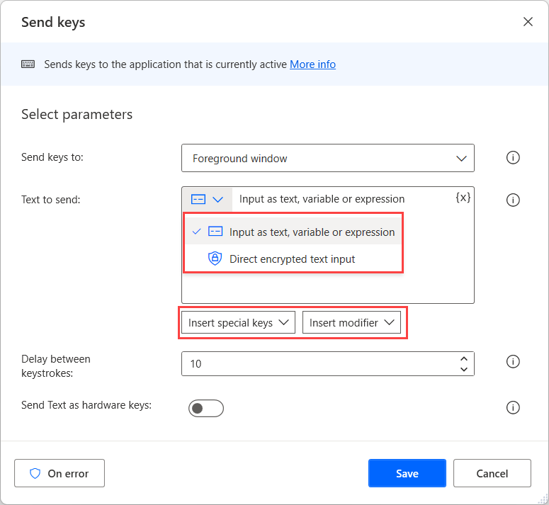
Mouse and Keyboard Actions (2/2)
Keyboard actions
Send Keys – Simulate using the physical keyboard to enter text or other key commands with the Send Keys action
Press/Release Key – Combine mouse and keyboard actions to perform more advanced gestures, such as Control+click or Shift+click
Set Key State – To enable or disable Caps Lock, Num Lock and Scroll Lock
Block Input – To ignore mouse or keyboard input from the user while the flow is running
Notes:
Send Keys
Enter the text to send or specify a text variable. Additionally, set Direct sensitive text input to hide the text in the action properties. Select the "eye" icon to show the text you entered. For more specialized key commands, use the Insert special key button to keys such as the arrow keys, Caps Lock or keys from the numeric keypad, and Insert modifier to send keys such as Shift and Control. Optionally, set a delay between the keystrokes in milliseconds.
Press/Release Key
Configure the action to simulate pressing and holding one or any combination of the keys Control, Alt, Shift and/or the Windows key.
Set Key State
To enable or disable Caps Lock, Num Lock and Scroll Lock, use the Set Key State action.
Block Input
To ignore mouse or keyboard input from the user while the flow is running, use the Block Input action.

Slide 65
Exercise: Use the Recorder to Automate Desktop Applications
Follow the exercise on Learn
In this exercise, you’ll automate a desktop-related task to get a better grasp of the recorder’s functionality in desktop automation.
Time estimate: 15 minutes
Notes:
https://learn.microsoft.com/en-us/training/modules/pad-power-automate-desktop-recording-features/4-exercise-recording-desktop-flows

Slide 66
Module 3 – Summary
Power Automate for desktop uses UI elements to interact with local application UIs and windows.
UI elements can be added from the flow designer’s UI elements tab, or directly from a relevant action’s properties; they can then be used as input in UI/Windows actions.
UI/Windows actions interact with entire windows or elements within them.

Slide 67
Module 4:Automating Web Applications

Slide 68
Module 4 – Introduction
Web applications are unquestionably an integral part of the technological infrastructure of most companies.
To provide automation solutions for these applications, Power Automate for desktop supports all major browsers through its browser automation actions.
In this module, you will:
1
Learn how to configure browser automation actions.
2
Learn how to extract data from web pages.
3
Create a flow that extracts gainer stocks from the MSN website.
Notes:
Power Automate for desktop supports all major browsers through its browser automation actions. More precisely, it supports the handling of the following browsers:
Microsoft Edge
Microsoft Internet Explorer
Google Chrome
Mozilla Firefox
Built-in automation browser
With such comprehensive support, users can handle any element in web pages and perform data extraction operations.
Prerequisites
Basic familiarity with the Power Automate for desktop console and flow designer.
Basic familiarity with flow development and variables.
Basic familiarity with the UI elements pane.

Slide 69
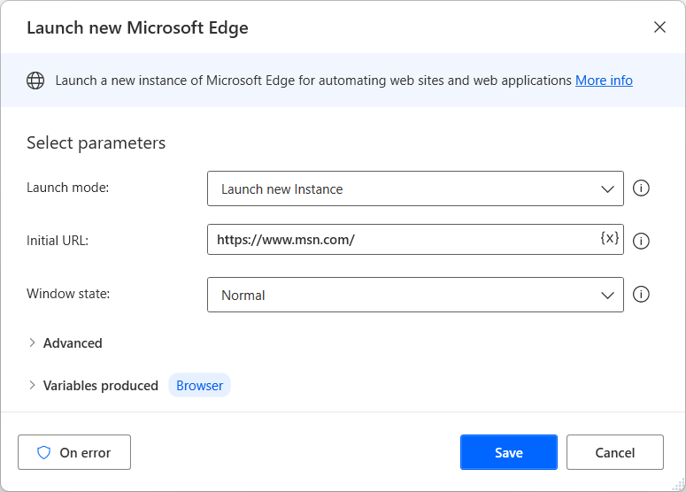
Launch, Close, and Handle Browsers
Launching actions
Launch new Edge
Launch new Internet Explorer
Launch new Chrome
Launch new Firefox
Other actions
Close web browser
Go to web page
Create new tab

Slide 70
Handle Web Pages and Forms
Power Automate for desktop enables you to interact with any web application through UI elements.
To specify a UI element, you have to create Cascading Style Sheets (CSS) selectors that pinpoint the specific component you want to interact with.
All the actions that handle specific components in web pages require UI elements as input parameters.
Functionality of all the web actions
Click link on web page
Click download link on web page
Hover mouse over element on web page
Populate text field on web page
Focus text field on web page
Set checkbox state on web page and select radio button on web page
Set drop-down list value on web page
Press button on web page
Notes:
To create a UI element, follow the following steps:
Open the action's properties and select the UI element drop-down menu.
Select one of the already created UI elements or create a new one through the Add UI element button.
If you chose to create a new one, use the Live helpers (red boxes) to select the desired component.
Press Ctrl + left-click while the desired component is selected to create a new UI element for it.
Confirm the selection in the Tracking session dialog.
Click link on web page
In some cases, you might need to navigate manually to a web page by clicking a link instead of using the Go to web page action. In these cases, you can use the Click link on web page action that enables you to select links or other clickable components on web pages.
In the action's properties, you have to populate a UI element describing the exact component to select and a browser instance.
Click download link on web page
If you want to click a download link, you can use the Click download link on web page action instead of the Click link on web page action. Apart from the link selection itself, this action automatically handles the pop-up dialog boxes and saves the downloaded file in a specified folder.
Like the Click link on web page action, the Click download link on web page action requires a browser instance and a UI element describing the link.
Hover mouse over element on web page
While automating business procedures, you might want to relocate the mouse pointer to a specific element on a web page. A typical case where you need this functionality is the expansion of hoverable menus.
To achieve this functionality, you can use the Hover mouse over element on web page action. Inside the action, you have to specify the browser instance and a UI element describing the component to hover over.
Populate text field on web page
While filling forms, it is common to populate text fields. To automate procedures that populate this kind of fields, you can use the Populate text field on web page action.
In the action's properties, you have to set the text to write, the browser instance, and the UI element describing the text field. Additionally, you can determine whether the action will emulate typing.
Focus text field on web page
Although Power Automate for desktop provides an action to populate text fields automatically, you might want to just set the input focus on them.
The platform enables you to do that through the Focus text field on web page action. In the action's properties, you have to populate a UI element describing the text box and a browser instance.
Set checkbox state on web page and select radio button on web page
Except for text fields, the majority of the web forms contain checkboxes and radio buttons.
To enable or disable checkboxes, you can use the Set checkbox state on web page action. This action requires the checkbox's desired state, a browser instance, and a UI element describing the check box.
To select a radio button, use the Select radio button on web page action. Like the Set checkbox state on web page action, you have to define a browser instance and a UI element describing the button.
Set drop-down list value on web page
Some relatively common components in webpages and web forms are the drop-down lists. Drop-down lists allow you to select a single option from a provided list of options. To automate these components, you can use the Set drop-down list value on web page action.
This action enables you to select the desired option through its name or index. In the action's properties, you have to populate a browser instance and a UI element describing the drop-down list.
Press button on web page
The last action to handle web forms is the Press button on web page action. Through this action, you can press buttons on web pages. To specify the button to press, you have to create a UI element, while the action also requires a browser instance.

Slide 71
Extract Data from Web Pages
Power Automate for desktop enables you to
Get details of web page
Get details of element on web page
Take screenshot of web page
Advanced data extraction
It’s common in business procedures to extract web data displayed in the form of tables and lists.
Extract data from web page
Single value
Handpicked (multiple) values
Lists
Tables
Notes:
Get details of web page:
Through this action, you can retrieve descriptive details about web pages, such as its title, metadata keywords, and description. In the action's properties, you have to specify the browser instance and the desired information to retrieve.
Get details of element on web page:
This action requires a browser instance and a UI element describing the element.
Take screenshot of web page:
Deploying this action, you can take a screenshot of the entire web page or a specific element. The action allows you to store the taken screenshot to the clipboard or a file.
Advanced data extraction
To specify which data to extract, you have to launch a browser window while the Extract data from web page is open and wait for the Live web helper dialog to appear.
While the platform displays the Live web helper dialog, right-click on the desired element, select Extract element value, and choose the property you want to extract.
If you repeat the selection for another corresponding value, the action will extract a list containing each related element's respective value.
If you select an additional value, Power Automate for desktop will return a data table containing each element's corresponding data in the list.
To extract data spread throughout multiple pages, right-click on the website's pager button and select Set element as pager.
If you want to modify the CSS selectors manually, select the Advanced settings option. Manually selector editing allows you to create complex selectors when the automatic selection doesn't satisfy your needs.
To discard a selection you have made, select the Reset button on the Live web helper dialog.
Lastly, you can select the Refresh button to highlight which data to extract based on the current selection. You can take advantage of this feature when you want to repeat a similar extraction for multiple pages.

Slide 72
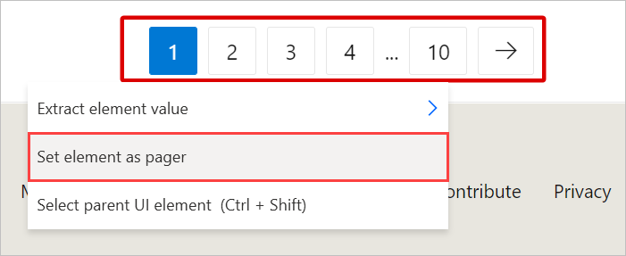
Handling Multiple Pages
Pagers are web elements that allow you to navigate between multiple pages
Configure extract data from web page action to select between extracting data from all the available pages or a specific number of them
Notes:
To set a pager for the data extraction, select or right-click the respective pager element and select Set element as pager

Slide 73
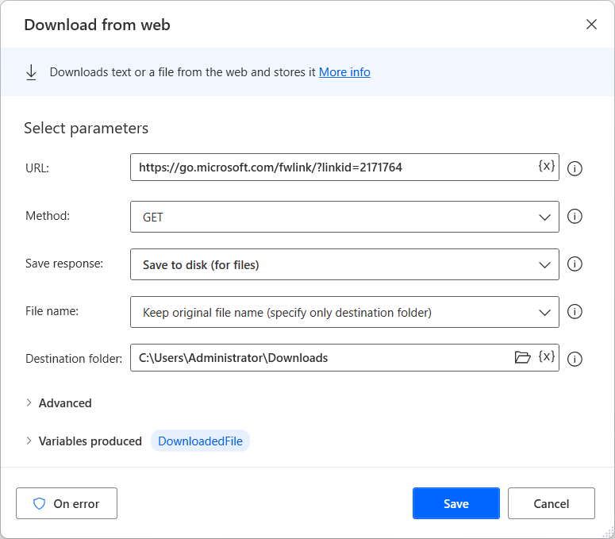
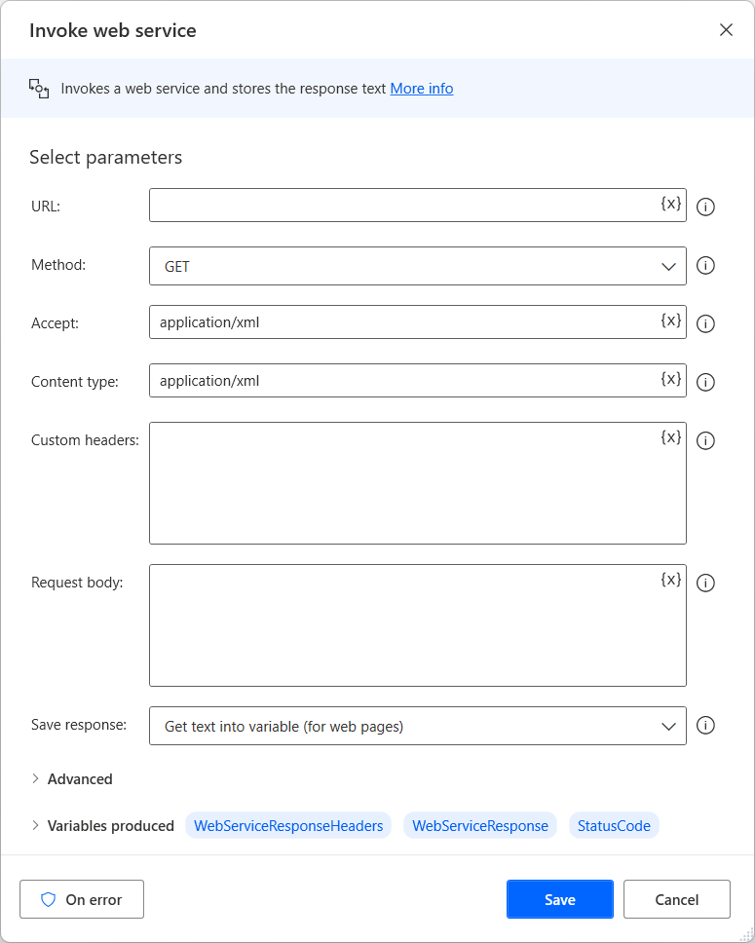
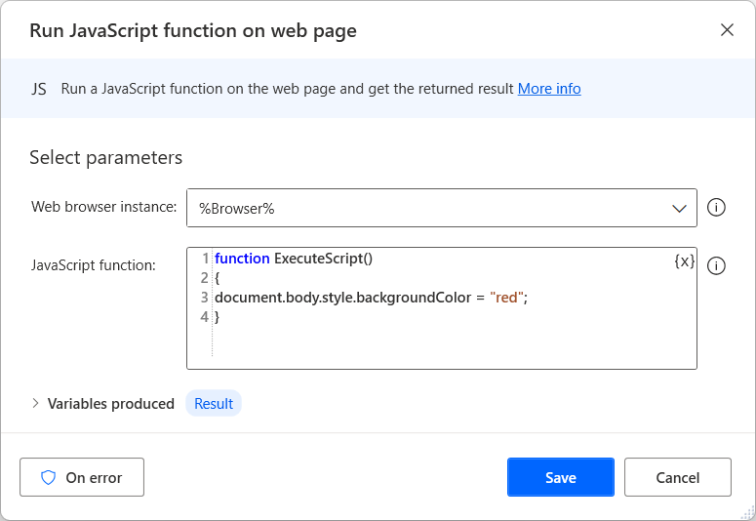
Direct Web Access and Scripting
Power Automate for desktop provides three actions that enable you to interact with APIs and run scripts on web pages
Run JavaScript function on web page
Download from web
Invoke web service
Notes:
Download from web
Through the Download from web action, you can download text and files from web pages. To use this action, you need to specify the URL of the desired page and the appropriate method (GET or POST).
The action stores the returned text into a variable, while the downloaded files are saved locally.
Invoke web service
In case you want to communicate directly with web services and APIs to reduce the complexity of your flows, you can use the Invoke web service action.
Every web service comes with API documentation that specifies the appropriate input parameters. The use of invalid parameters might cause an exception.
The action stores the text responses into a variable, while the retrieved files are saved locally.
Run JavaScript function on web page
If you want to execute custom behavior through scripts, you can use the Run JavaScript function on web page action. This action accepts a browser instance and a JavaScript function as inputs and then stores the result of the implementation in a produced variable.
The JavaScript function field automatically creates the structure of a predefined JavaScript function.

Slide 74
Exercise: Extract Stocks from MSN
Follow the exercise on Learn
In this exercise, you’ll create a flow that extracts gainer stocks from the MSN website and stores them in a new Excel worksheet.
Time estimate: 15 minutes
Notes:
https://learn.microsoft.com/en-us/training/modules/pad-web/6-exercise

Slide 75
Module 4 – Summary
Power Automate for desktop supports the automation of virtually any web-related procedure through its browser automation actions.
These actions support all major browsers, such as Microsoft Edge, Microsoft Internet Explorer, Google Chrome, and Mozilla Firefox, while the platform also offers its own built-in browser.
Apart from web handling, Power Automate for desktop supports data extraction and API communication.

Slide 76
Module 5: Advanced Flow Scenarios

Slide 77
Module 5 – Introduction
Advanced flow scenarios
In this module, you will:
1
Understand how to handle exceptions
2
Explore how to work with Folder and File actions
3
Explore how to work with Microsoft Excel actions
4
Understand options for automating web mail and Outlook
5
Explore Text, Date and OCR actions
Notes:
Prerequisites
Basic familiarity with the Power Automate for desktop console

Slide 78
About Exceptions
Exceptions
Exceptions are events that occur while a flow is running.
Exceptions may be caused by various factors: Incorrect inputs, unexpected values, software/hardware failures, unavailable resources, etc.
Handling exceptions
When an exception occurs, the default behavior would be to stop the flow, and generate an error. However, this behavior can be modified, so as to remedy the situation and prevent the flow from stopping.

Slide 79
Exception Handling
1
Action-level exception handling
In the initial example, we mentioned that the client’s database may be inaccessible, causing the action that communicates with the database to produce an exception. To prevent this, open the action’s properties, and press the On error button.
2
Block-level exception handling
There are cases where one cannot be certain which action is at risk of failing, and it is not practical to apply the same exception handling rules to every single action.
3
Exception handling priorities
The order in which exception handling is applied is from the bottom up.

Slide 80
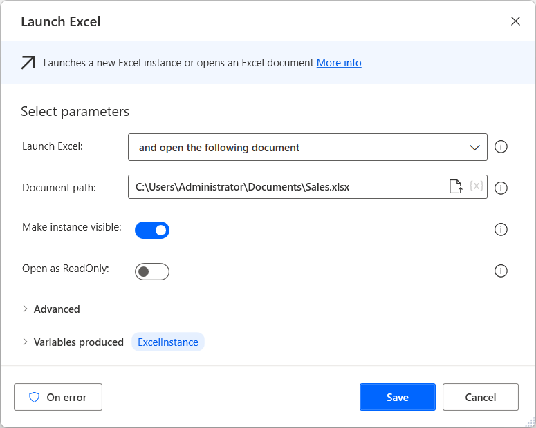
Deploy Exception Handling
To avoid errors, users may configure exception handling rules, so that the flow can recover and continue running.
Exception handling
Exceptions may occur from virtually any action. For this reason, most actions’ properties contain an On error button.
Notes:
In our example flow, for instance, the Excel file to be processed may not exist in the path specified because it may not have been moved from its initial path to the working one we have entered in the flow. If we know the initial path, we could configure the Launch Excel action so that, if it fails to open the file, it will attempt to open it from its initial path.
To achieve this, we will double-click on the action to edit it
And press the On error button
The selected options will take effect when this action encounters an exception. To open a file in a different path, we will have to create a new subflow that does exactly that
Then configure the previous action’s exception handling accordingly, by pressing New rule and selecting Run subflow
Configured as above, if the Excel file cannot be opened in its usual path, the Alternative Path subflow will run, opening the file in its alternative path; then, the flow will resume running

Slide 81
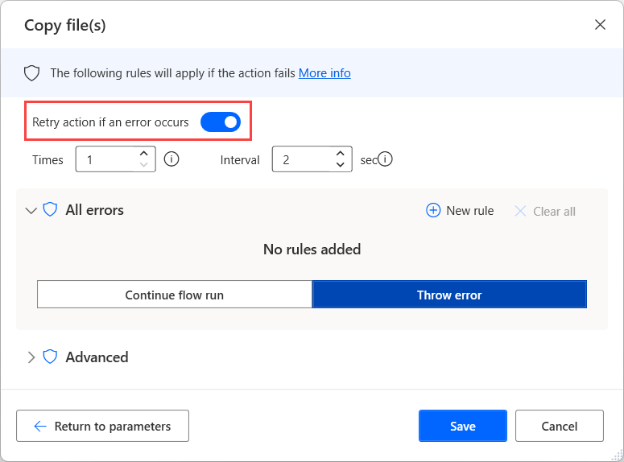
Configure Retry on Error
The flow runs the action a set number of times after a set number of seconds
The default value is one retrying with an interval of two seconds

Slide 82


Other Options to Handle the Error
Notes:
Go to next action: Runs the following action in order.
Repeat action: Repeats the action until it runs successfully.
Go to label: Run the desktop flow from a point defined by a Label action.
Set variable: Sets the specified value to a selected variable.
Run subflow: Runs a specified subflow.

Slide 83

Handle Errors of Group of Actions
Some scenarios may require you to implement the same error-handling functionality for several actions in your desktop flows
Use the On block error action and configure error-handling for all the actions inside the block

Slide 84
Folder Actions
1
Get special folder – To retrieve the paths of commonly used directories, which vary among different users and computers
2
Create folder – Create new folders
3
Copy folder – Copy a folder to a different directory
4
Move folder – Copy a folder to a new destination
5
Rename folder – Rename a folder
6
Delete folder – Delete folders
7
Get subfolders in folder – Get a list of a folder’s contents
Notes:
Get special folder
Under Special folder name, select the directory to retrieve, and its path will be displayed beneath. The action stores the path in a variable to use with other file and folder handling actions.
Create folder
Specify the directory where you want to create the folder and the name of the new folder. For example, the Create folder action can reference the output of the Get special folder action.
Copy folder
This action requires you to fill in the Folder to copy and Destination folder fields.
If a folder already exists with the same name as the one that you want to copy into the Destination folder field, use the If folder exists drop-down menu to set this option to Overwrite to overwrite the folder in the destination, or you can set it to Do nothing.
Move folder
Note that when you move rather than copy a folder, it is deleted from its original location. The folder to move and the destination folder are required inputs.
Rename folder
Specify a folder to rename and a new name.
Delete folder
If you want to delete only the contents of the folder rather than the actual folder, use the Empty folder action. Specify the folder by file path or variable.
Get subfolders in folder
This action will retrieve a list of folders inside the specified (parent) folder and will provide as output a list of folders.
Additionally, to filter the output by folder name, configure a Folder filter.
Include additional layers of subfolders by selecting the Include subfolders check box.
Set the action to fail if access is denied to any of the subfolders, or you can sort the output sequentially by three fields in the Advanced section. Selecting the Descending check box will sort the output by the selected field in descending order, as opposed to ascending order if the check box is cleared.

Slide 85
File Actions
Get files in folder – To get a list of all files in a specified folder
Copy file(s) – To copy files
Move file(s) – To move files
Delete file(s) – To delete files
Rename files – Change the name of one or more files
Read text from file – Perform file-related operations based on the contents of a file
Write text to file – Add text to a file or to create a new file with the specified text.
Read from CSV file – Read data from a comma-separated value (.csv) spreadsheet file
Write to CSV file – Write any DataRow or DataTable type variable to a .csv file
Get file path part – Retrieve one or more parts from a text that represents a file path
Notes:
Get files in folder
The path of the folder is a required input and you can specify it as a variable.
Optionally, you can filter files by using the File filter action.
You can sort the output and set the action to Fail upon denied access to any subfolder in the Advanced section.
Copy file(s)
These actions take as input a file, or a list of files, and a destination folder. Set If file exists to Overwrite or Do nothing.
Move file(s)
These actions take as input a file, or a list of files, and a destination folder. Set If file exists to Overwrite or Do nothing.
Delete file(s)
It requires the file or list of files as input.
Rename files
This action contains a variety of ways to dynamically alter a file name. As with the previous actions, the required input is a file or list of files. Additional requirements depend on the option that is selected in the Rename scheme drop-down menu.
Read text from file
This action stores text from a .txt file in a variable. The required input is a .txt file, and the file content is stored as a single text value or as a list. Select a list, and each line of text in the file will be an item in the list. Also, you can select the encoding of the input file from a list of options.
Write text to file
This action requires the path for the text file and the text to append. You can also select to append a new line at the end of the written text. If the file exists, you can select to either overwrite the existing content or append it to the file.
Read from CSV file
The action requires the path to the .csv file and the encoding of the file. The output is a DataTable type variable with the contents of the .csv file.
The Advanced section includes multiple options for handling the data in the .csv file:
Trim (remove whitespaces from the beginning and end) the value in each cell to ensure consistency of data and remove redundancy.
If the First line contains column names check box is selected, the first line will not be stored in the output variable.
Additionally, you can change the columns separator if a different symbol is used in the file.
Write to CSV file
Specifying the path of the file and the variable to write are required inputs.
Get file path part
Requires a file path as input and breaks it down into multiple components, which are all stored as variables.

Slide 86

Launch, Save, and Close an Excel file (1/2)
Open an Excel file and create an instance
The first task in automating any Excel-related task is to create an Excel instance.
Create instances by opening a locally stored or new Excel file or by attaching the flow to an already opened file.
These operations are achieved by the Launch Excel action or the Attach to running Excel action.
Notes:
Launch Excel
To open a new Excel file, under Launch Excel, select with a blank document.
Alternatively, launch Excel with an existing file by changing the Launch Excel setting to and open the following document. Enter a Document path, or browse for and select a file.
Attach to running Exce
Use an already opened Excel file as an instance with the Attach to running Excel action. With this action, specify the Document name.

Slide 87

Launch, Save, and Close an Excel file (2/2)
Save and close an Excel file
You can save and close an Excel file only if the instance has already been determined.
Save Excel
Save mode:
Save document
Save document as
Close Excel
Before closing Excel:
Do not save document
Save document
Save document as

Slide 88

Read from an Excel Document
Read and extract data from an Excel document with the Read from Excel worksheet action.
The Retrieve option:
The value of a single cell – Retrieve the contents of a single cell
Values from a range of cells – Extract a table of data
All available values from worksheet – Retrieve all data from an Excel worksheet

Slide 89

Write to an Excel Worksheet
Write data from the flow to Excel by using the Write to Excel worksheet. This action can write any static data or variable to a specified cell, or multiple cells in an Excel worksheet.
The action supports two writing modes:
Write on a specified cell
Write on the currently active cell
Notes:
To write an entire table to Excel, set a data table as Value to write. The specified or active cell is the upper-left cell of the written table.
The Write to Excel worksheet action accepts as input a previously defined Excel instance and doesn't return any outputs.

Slide 90
Additional Actions and Features
1
Get first free row on column from Excel worksheet – To write data to the first available cell in a given column
2
Get selected cell range from Excel worksheet – To provide the indices of the first and last column and row of the selection
3
Select cells in Excel worksheet – To change the selected cells
4
Activate cell in Excel worksheet – To activate a particular cell
5
Insert row to Excel worksheet – To insert columns and rows
6
Delete row from Excel worksheet – To delete columns and rows
7
The Run Excel macro – Runs a specified macro saved in the workbook

Slide 91

Manage Worksheets
Set active Excel worksheet – Specify the worksheet by name or index
Get all Excel worksheets – To get the names of all worksheets in a document
Get active Excel worksheet – To retrieves the name and index of the currently active worksheet

Slide 92

Automate Webmail Services (1/2)
Configure IMAP and SMTP servers
Before deploying any email actions, you have to configure the server that will handle the requests.
The Retrieve email messages and Process email messages actions require an IMAP server
The Send email action requires an SMTP server

Slide 93
Automate Webmail Services (2/2)
Retrieve email messages
To retrieve emails that meet specific criteria from your mailbox
Process email messages
This action runs a series of essential email handling operations, such as deleting, marking as unread, and moving messages to other folders.
Send email
To create and send new email messages.
To deploy this action, you have to specify the following elements:
Sender
Sender’s display name
Recipient
CC and BCC recipients
Subject and body of the new email

Slide 94
Automate Outlook
1
Launch and close Outlook
2
Retrieve email messages from Outlook
3
Send email message through Outlook
4
Process email messages in Outlook
5
Save Outlook email messages
6
Respond to Outlook message
Notes:
Launch and close Outlook
Before deploying any Outlook actions, use the Launch Outlook action to launch Outlook and create an instance variable of it. This action doesn't require any parameters, while the other Outlook actions require the created instance.
When you no longer need the created instance in the flow, deploy the Close Outlook action to close it.
Retrieve email messages from Outlook
To limit the retrieved emails, you can filter them according to their parent folder, state, or keywords included in various fields. If the retrieved emails contain attachments, the action allows you to save the files locally on your desktop.
Send email message through Outlook
In the action's properties, you can specify the following elements:
Sender
Recipient
CC and BCC recipients
Subject and body of the new email
Optionally, you can write the email body in HTML and attach files to the message. To attach a file, populate the file path or a variable containing the file (or a list of files) in the Attachment(s) field.
Process email messages in Outlook
This action runs a series of essential email handling operations, such as deleting, marking as unread, and moving messages to other folders.
To use this action, you have to set a list of emails as input. This list can be created by the Retrieve email messages from Outlook action.
Save Outlook email messages
This action requires a list of emails that can be retrieved using the Retrieve email messages from Outlook action.
You can save the extracted emails into various file types, such as Outlook Message, HTML, and text. To name the files manually, select Custom in the File name dropdown menu and populate the Save as field.
Respond to Outlook message
This action responds to an Outlook message by replying, replying to all, or forwarding.
In the action's properties, you have to populate an email variable. You can use an individual element of an email list retrieved with the Retrieve email messages from Outlook action.
Apart from text, the action allows you to attach files to your replying message. To attach a file, populate the file path or a variable containing the file (or a list of files) in the Attachment(s) field.
If you select to forward an email, you should also populate the primary recipient, as well as the CC and BCC recipients.

Slide 95
Automate Exchange Servers
1
Connect to an Exchange server
2
Retrieve Exchange email messages
3
Send an Exchange email message
4
Process Exchange email messages
Notes:
Connect to an Exchange server
In the action's properties, you can set the Exchange server's version and select whether the server will be detected automatically through the email address.
Additionally, you can choose between setting the credentials to the Exchange default or specifying them manually. The action stores the established connection to a variable for late use in other Exchange actions.
Retrieve Exchange email messages
To limit the retrieved emails, you can filter them according to their parent folder, state, or keywords included in various fields. If the retrieved emails contain attachments, the action allows you to save the files locally on your desktop.
Send an Exchange email message
To send an email message, deploy the Send Exchange email message action, that creates and sends new email messages through a previously established Exchange server connection.
In the action's properties, you can specify the following elements:
Sender
Sender's display name
Recipient
CC and BCC recipients
Subject and body of the new email
Optionally, you can write the email body in HTML and attach files to the message. To attach a file, populate the file path or a variable containing the file (or a list of files) in the Attachment(s) field.
Process Exchange email messages
This action runs a series of essential email handling operations, such as deleting, marking as unread, and moving messages to other folders.
To deploy this action, you have to set a list of emails as input. This list can be created by the Retrieve Exchange email messages action.

Slide 96
System and Workstation Actions
Run application
Terminate process
Print document
Log off user
Shutdown computer
Show desktop
Lock workstation
Play sound
Empty recycle bin
Take screenshot
Control screen saver
Ping
Set Windows environment variable
Get Windows environment variable
Delete Windows environment variable
Set screen resolution
Get screen resolution
Notes:
Run application
In Power Automate for desktop, use flows to launch any of your installed applications with the Run application action. In addition to running applications, open any document or file with this action. The action requires the application path and command-line arguments. Optionally, also set a working folder. Set the window state of the application to Maximized, Normal, Minimized, or Hidden, and configure the action to wait for the launched application to load or complete.
Terminate process
Stop any currently running processes in Windows with the Terminate process action. Specify the process by name or ID. Either choice requires the input of the corresponding identifier.
Print document
The Print document action requires a file path to print the specified document.
The Set default printer action requires you to choose from a drop-down list of detected printers and then sets it as the default printer.
The Get default printer action retrieves the name of the default printer and then stores it in a variable.
Log off user
Log the current user off with the Log off user action, with an option to Force log off if any applications are preventing the operation.
Shutdown computer
Shutdown, Restart, Suspend, or Hibernate the computer with the Shutdown computer action. The Force selected action check box allows the selected operation to persist in case applications are preventing shutdown.
Show desktop
Use the Show desktop action to minimize or restore all currently opened windows.
Lock workstation
Lock the workstation to prevent unauthorized access with the Lock workstation action. This action contains no editable properties.
Play sound
Play a sound at any point during the flow with the Play sound action. Set the action to play a specified system sound or play a .wav file. If you select a .wav file, you will be required to enter the file path.
Empty recycle bin
Permanently delete all contents of the recycle bin using the Empty recycle bin action. This action contains no editable properties.
Take screenshot
Take a screenshot of the specified screen, all screens, or the foreground window only with the Take screenshot action. Copy the image file to the clipboard or save it to a file. To save the screenshot to a file, specify a path and image format.
Control screen saver
Enable, disable, start, or stop the screensaver with the Control screen saver action.
Ping
To ping a remote computer, use the Ping action. Specify the remote computer by name or IP, with a configurable timeout. The result and roundtrip time are stored in separate variables.
Set/Get/Delete Windows environment variable
Set Windows environment variables with the Set Windows environment variable action. Specify an environment variable, a value to set, and a type (user or system). The Get Windows environment variable action retrieves the value of the specified variable name and store it into a variable. The Delete Windows environment variable action deletes the variable with the specified name and type.
Set/Get screen resolution
Set a width, height, bit count, and frequency for the specified monitor with the Set screen resolution action. The Get screen resolution action retrieves the settings mentioned above for the specified monitor and stores them into separate variables.

Slide 97

Services Actions
Power Automate for desktop allows users to handle services on their Windows machine through the services actions.
With these actions, users can maintain full control of the operating system and limit the running services.
This group contains four actions:
Start service
Stop service
Pause service
Resume service
Notes:
All actions of the group require the service name as input. Enter the name of a service, or select one from the drop-down list. None of the actions return any output.

Slide 98
Text Handling Actions (1/3)
To perform operations with text type variables, the text actions require specifying the text either by entering it as input, or as a text variable.
1
Append line to text – To add a line of text to a single text value or list of text values
2
Get subtext – To retrieve a specific portion of a text or list of text values
3
Pad text – Pad text by adding a whitespace, word or phrase before or after the text or a list of text values
4
Trim text – To remove whitespace from a text string
5
Change text case – To change the case of a text value
Notes:
Append line to text
The action stores the resulting text in a new text variable.
Get subtext
Set the Start index property to retrieve text starting at a character position or at the start of the text, and set the Length property to end at another position or at the end of the text. The action stores its output in a text variable.
Pad text
The action adds the specified characters to the text so that the resulting text reaches the specified length. Optionally, enter the text value to pad, or the characters that are used to pad the text value, as variables. The action stores the padded text a new text variable.
Trim text
Trim whitespaces from the beginning of a text string, the end of a text string, or both.
Change text case
Apply the Change text case action to a single text value or list of text values.
Note:
To get the length of a text variable use the following syntax:
%Variable.length%
This will return the numerical value of a text variable's length.

Slide 99
Text Handling Actions (2/3)
Text, dates, and numbers
Four text actions are dedicated to converting text values to and from the number and datetime data types.
Convert text to number
To ensure that numbers are stored as numerical values
Convert number to text
Performs the reverse conversion of the Convert text to number action
Convert datetime to text
To convert a datetime value to text
Convert text to datetime
Performs the reverse conversion of the Convert datetime to text action
Notes:
Convert text to number
This action requires as input single text items, text list items, datarow items, or datatable items. For list, datarow, or datatable items, the item’s index must be specified.
Convert number to text
Enter a number or a numeric variable to convert to a text variable. Set the number of decimal places to include, and configure the digit grouping options.
Convert datetime to text
This action's properties contain several options regarding the format of the datetime input. For example, convert a datetime variable that was created with the Get current date and time action to text using this action.
With this approach, the datetime value is guaranteed to be in a recognizable format. Alternatively, use a custom value as input. In this case, ensure that it is in a compatible datetime format. Configure the action to save datetime as text by using one of the available formats or a custom format.
Convert text to datetime
Enter a text value or variable that uses a compatible datetime format. If the value that was entered uses a custom format, select the Date is represented in custom format check box in the properties and then define the custom format in the field that appears underneath.
Date formatting
When displayed on their own, the following characters produce the following formats.
d The short date (04/02/2010)
D The long date (Friday, April 02, 2010)
f The full date and time - short time (Friday, April 02, 2010 10:00 AM)
F The full date and time (Friday, April 02, 2010 10:00:46 AM)
g General date time - short time (04/02/2010 10:00 AM)
G The general date time - long time (04/02/2010 10:00:46 AM)
M The month and day of the month (April 02)
m The month and day of the month (April 02)
r A shorter full date (Fri, 02 Apr 2010 10:00:46 GMT)
R A shorter full date (Fri, 02 Apr 2010 10:00:46 GMT)
s The sortable date and time (2010-04-02T10:00:46)
t The short time (10:00 AM)
T The long time (10:00:46 AM)
y The month and year (April, 2010)
When used as a combination, the characters have the following representation.
d The day of the month as a number from 1 to 31 (2)
dd The day of the month as a number from 01 to 31 (02)
ddd The abbreviated day of the week (Fri)
dddd The full day of the week (Friday)
gg The period era (AD)
h The hour as a number from 1 to 12 (10)
hh The hour as a number from 01 to 12 (10)
HH The hour as a number from 00 to 23 (10)
m The minutes as a number from 0 to 59 (0)
mm The minutes as a number from 00 to 59 (00)
M The month as a number from 1 to 12 (4)
MM The month as a number from 01 to 12 (04)
MMM The abbreviated month (Apr)
MMMM The month (April)
s The seconds as a number from 0 to 59 (46)
ss The seconds as a number from 00 to 59 (46)
tt The AM/PM designator (AM)
y The last digit of the year (0)
yy The last two digits of the year (10)
yyyy The year (2010)
zz The time zone (+02)
zzz The time zone in full format (+02:00)

Slide 100
Text Handling Actions (3/3)
Additional text actions
Create random text
The action is ideal for generating passwords
Join text
To combine a list of text values into a single text value
Split text
To separate a single text value into a list of items
Parse text
Search for a text value for a specific string of text
Replace text
To find a string in a text and replace it with another string or character
Escape text for regular expression
To modify a regular expression so that the characters used in regular expressions are escaped and are treated as literal characters in the string
Notes:
Create random text
It can be configured to generate text of a certain length and include uppercase and lowercase letters, digits, and symbols.
Join text
Enter a list variable as its input. Separate the list items by using a delimiter, such as a space, or specify a custom delimiter.
Split text
Enter a value or a text variable as the input. Ideally, the text should include recognizable delimiters that separate the items. Select one of the standard delimiters or enter a custom delimiter.
Parse text
Set the action to search for the first occurrence, or all occurrences, of the text string. Optionally, set the action to Ignore case (thus making the search case-insensitive). The output of the action stores the position, or list of positions, as a numerical value (or list of numerical values) that indicates the position(s) where the search string was found in the text.
If the search string is not known beforehand, search for a regular expression. Select the Is regular expression check box to store the matched string of a regular expression in a new variable.
Replace text
The Text to parse, Text to find, and Replacement text are required inputs. Similar to the Parse text action, in the Replace text action, configure the search to be case-insensitive, or to contain regular expressions. Escape sequences enable the user to add characters, such as a tab or a new line, into the replacement text.
Escape text for regular expression
Use this action if a regular expression contains a variable with a text value to escape the value in the variable, thus ensuring that the regular expression handles all characters in the text.

Slide 101

Date Time Actions
Get current date and time – Retrieve the current date and time
Add to datetime – Add a specified amount of the selected time unit to a datetime variable
Subtract dates – Subtract dates
Notes:
Get current date and time
The action can be set to only retrieve the current date. The Time zone property can be set to the system default or you can set a specific time zone from the drop-down list of available options. The result of the action configuration is stored in a datetime variable.
Add to datetime
The time can be added in seconds, minutes, hours, days, months, or years, and the result is set to a new variable.
Subtract dates
The action subtracts Subtract date from From date and then stores the difference in days, hours, minutes, or seconds in a new variable.
A variable of the data type datetime has the following properties:
Year The year part of the datetime value.
Month The month part of the datetime value.
Day The day part of the datetime value.
DayOfWeek The name of the day (for example, Sunday, Monday, and so on).
DayOfYear The day of the year part of the datetime value (1-365/6).
Hour The hour part of the datetime value.
Minute The minute part of the datetime value.
Second The seconds part of the datetime value.

Slide 102

Perform OCR
Optical character recognition (OCR) enables you to locate and extract text from images or the screen
To perform OCR multilingual sources, use a Tesseract engine and enable the Use other languages option in the engine settings

Slide 103
Exercise: Exception Handling
Follow the exercise on Learn
Time estimate: 15 minutes
Notes:
https://learn.microsoft.com/en-us/training/modules/pad-exception-handling/4-exercise-exception-handling

Slide 104
Module 5 – Summary
How to handle exceptions
How to work with Folder and File actions
How to work with Microsoft Excel actions
Options for automating web mail and Outlook
Options for Text, Date and OCR actions

Slide 105
Module 6: Deploy and Monitor

Slide 106
Module 6 – Introduction
Basics about how desktop flows can be deployed and monitored.
In this module, you will:
1
How to deploy to other environments and users
2
Options for monitoring your desktop flows
Notes:
Prerequisites
Basic familiarity with the Power Automate for desktop console

Slide 107
Deploying Desktop Flows
1
To run desktop flows in other environments, transport the flow using solutions
2
To run desktop flows on other computers, make sure all necessary local apps are configured
3
Users who will run the flow must be licensed
4
The flow must be shared with any user that will run it

Slide 108

Monitor Desktop Flow Activity
From the Power Automate portal (Monitor > Desktop flow activity)
Available data for admins and makers

Slide 109

Monitor Errors
You can use the Errors section to identify the most common errors that occur while your flows run
Includes Top Errors, Top Failed flows, Top Machine failures, and error trends

Slide 110

Monitor your Machines
Use the Machines section to monitor your machines and machine groups
Information available includes connection status and versioning for each machine

Slide 111

Monitor Current Runs
You can use the Errors section to identify the most common errors that occur while your flows run
Info includes currently running and currently queued which can help identify your backlog of runs

Slide 112
Exercise: Building Desktop Flows
Follow the exercise on GitHub
In this lab, you will be creating two desktop flows. One to automate the funding Windows app and the other to automate the inspection website.
Time estimate: 1 hour and 30 minutes
Notes:
Head to lab2 in github to setup your lab environment - https://github.com/MicrosoftLearning/PL-500T00-Microsoft-Power-Automate-RPA-Developer/blob/master/Instructions/L02/Lab02_Build_Desktop_Flow.md

Slide 113
Module 6 – Summary
How to deploy to other environments and users
Options for monitoring your desktop flows

Slide 114
Closing slide

